Slide 1
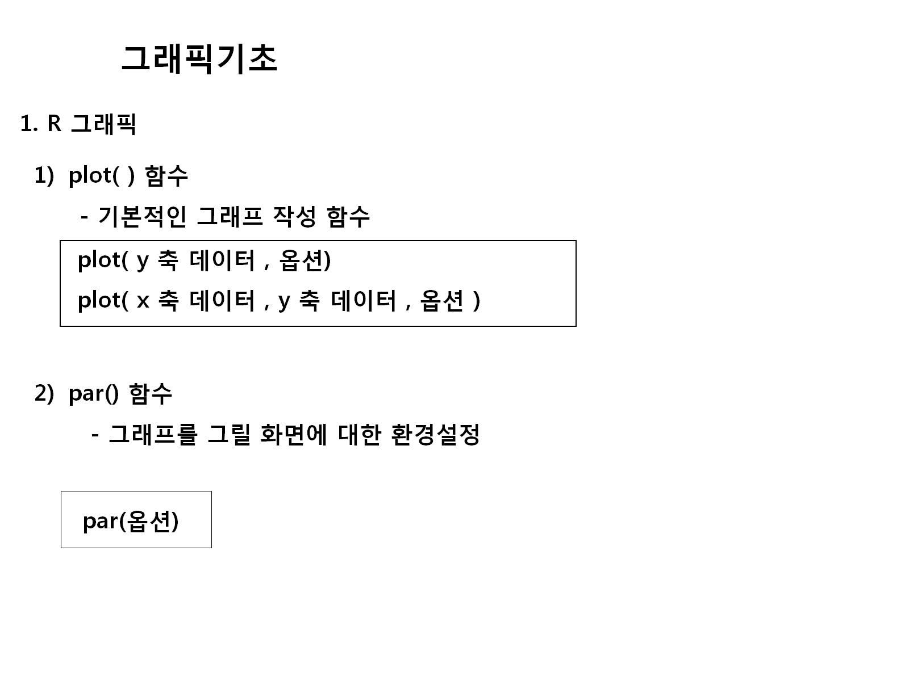

Slide 2
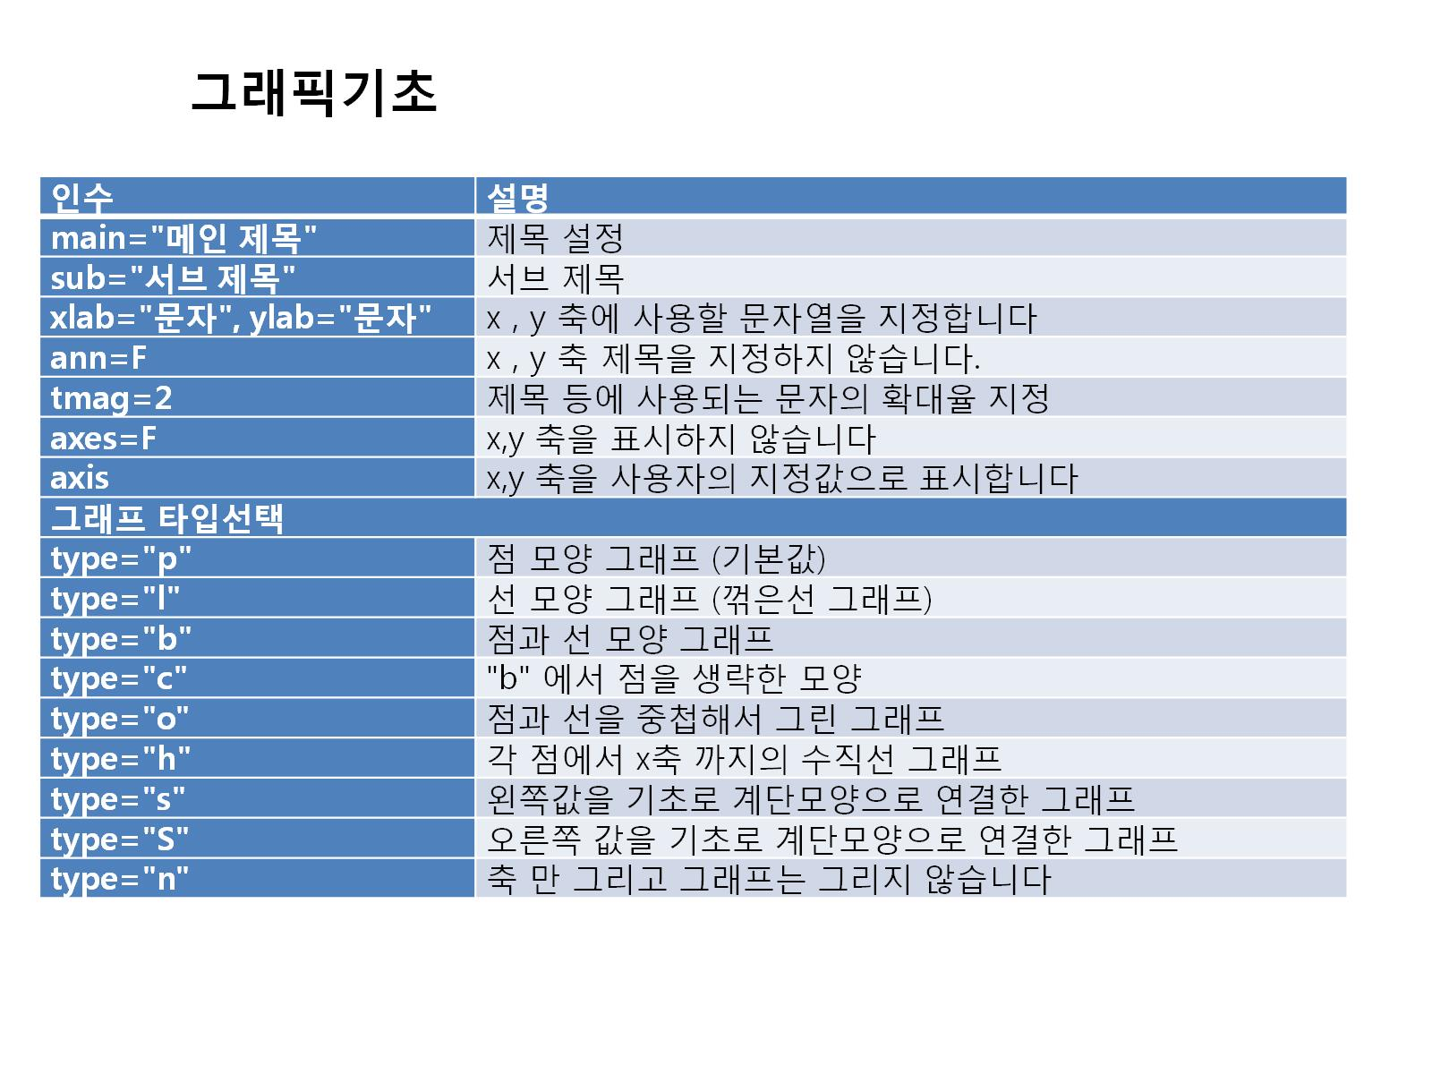

Slide 3
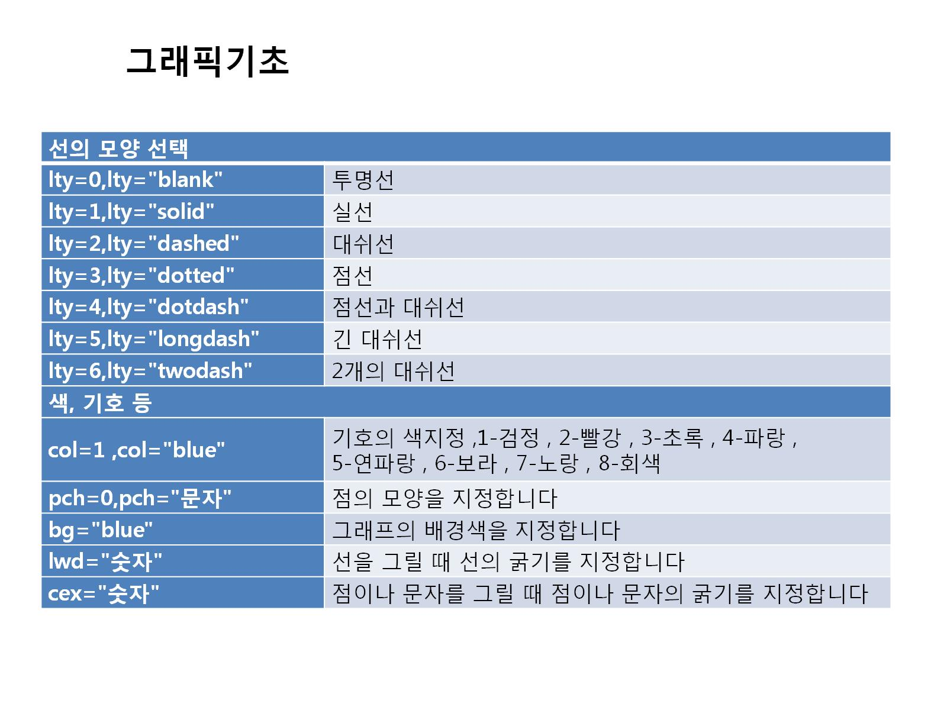

Slide 4
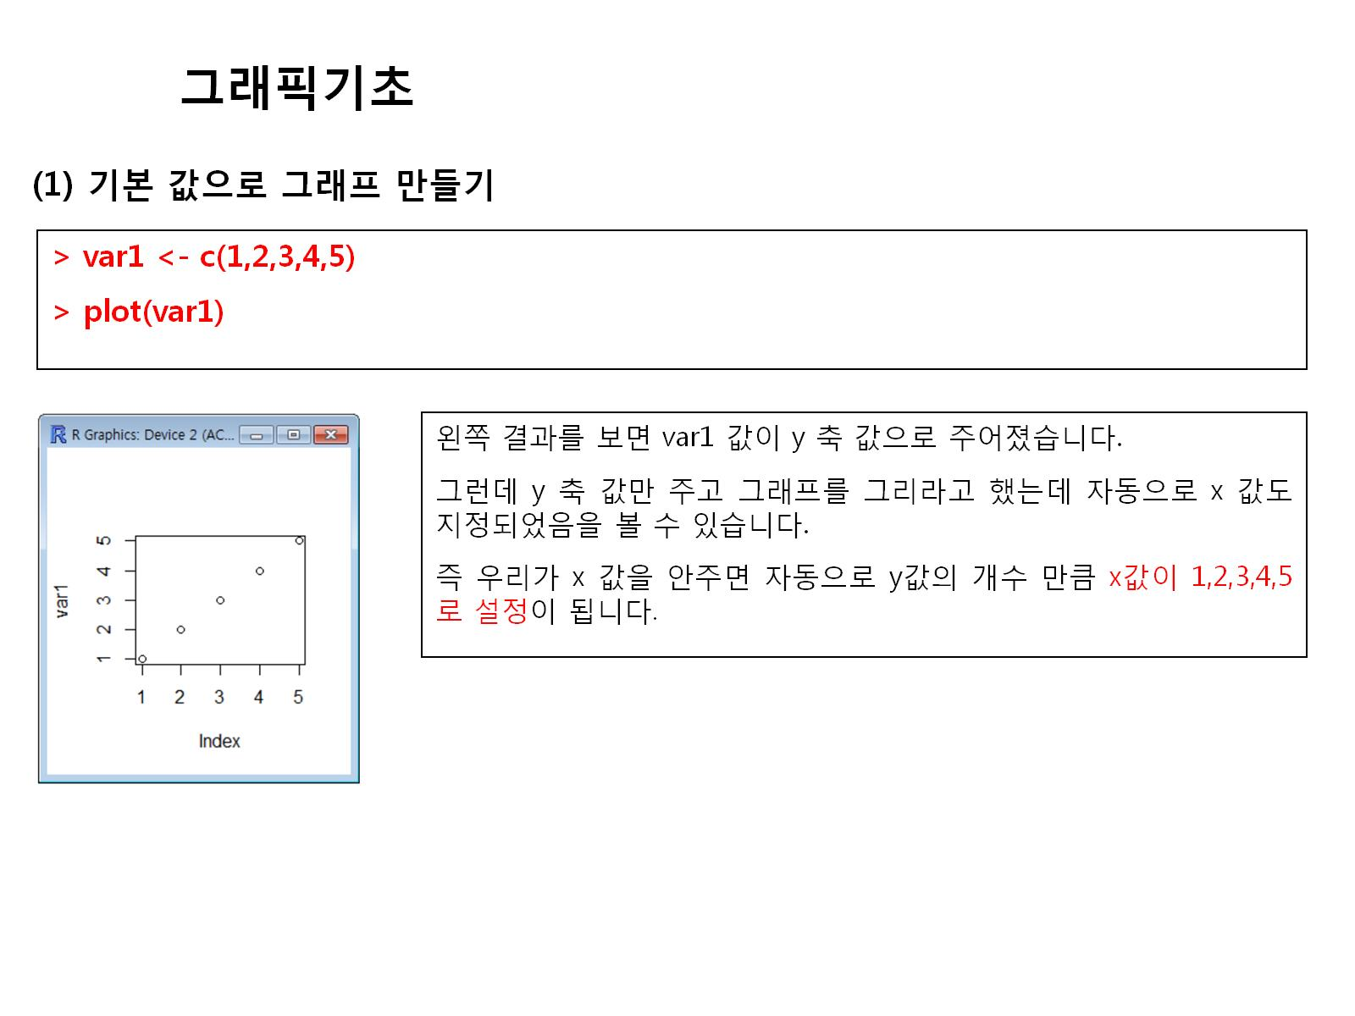

Slide 5
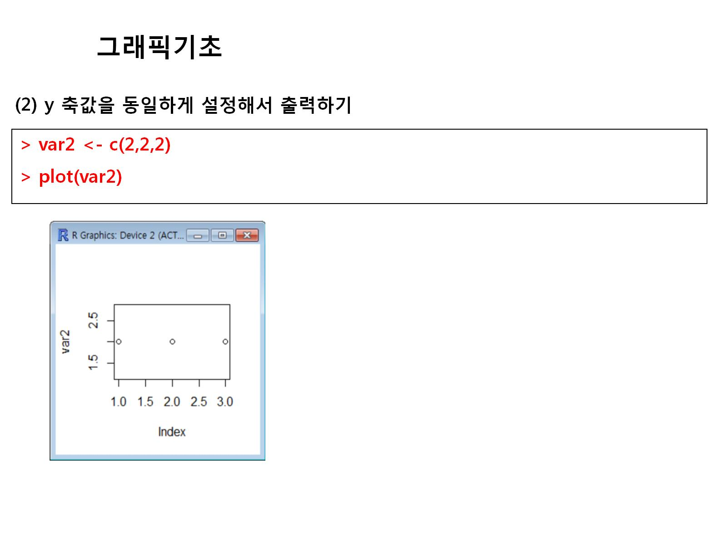

Slide 6
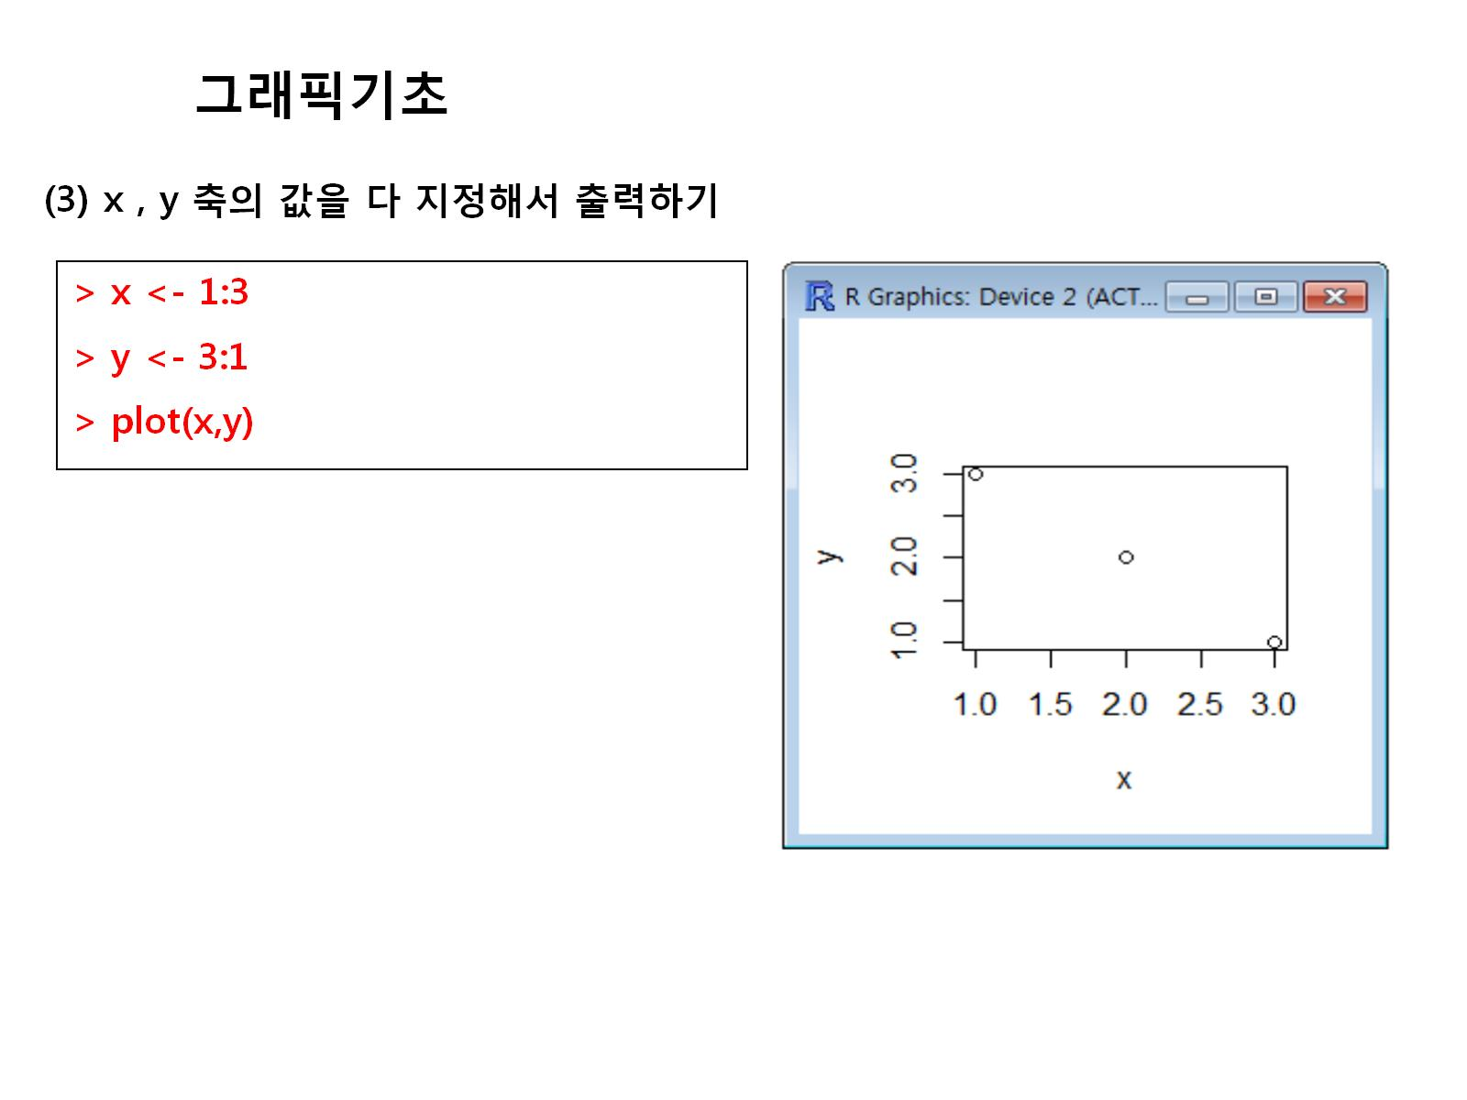

Slide 7
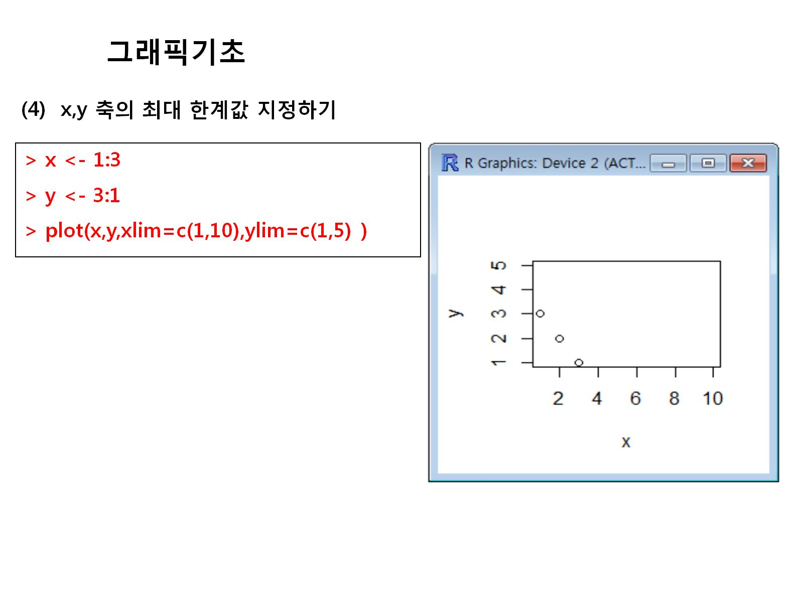

Slide 8
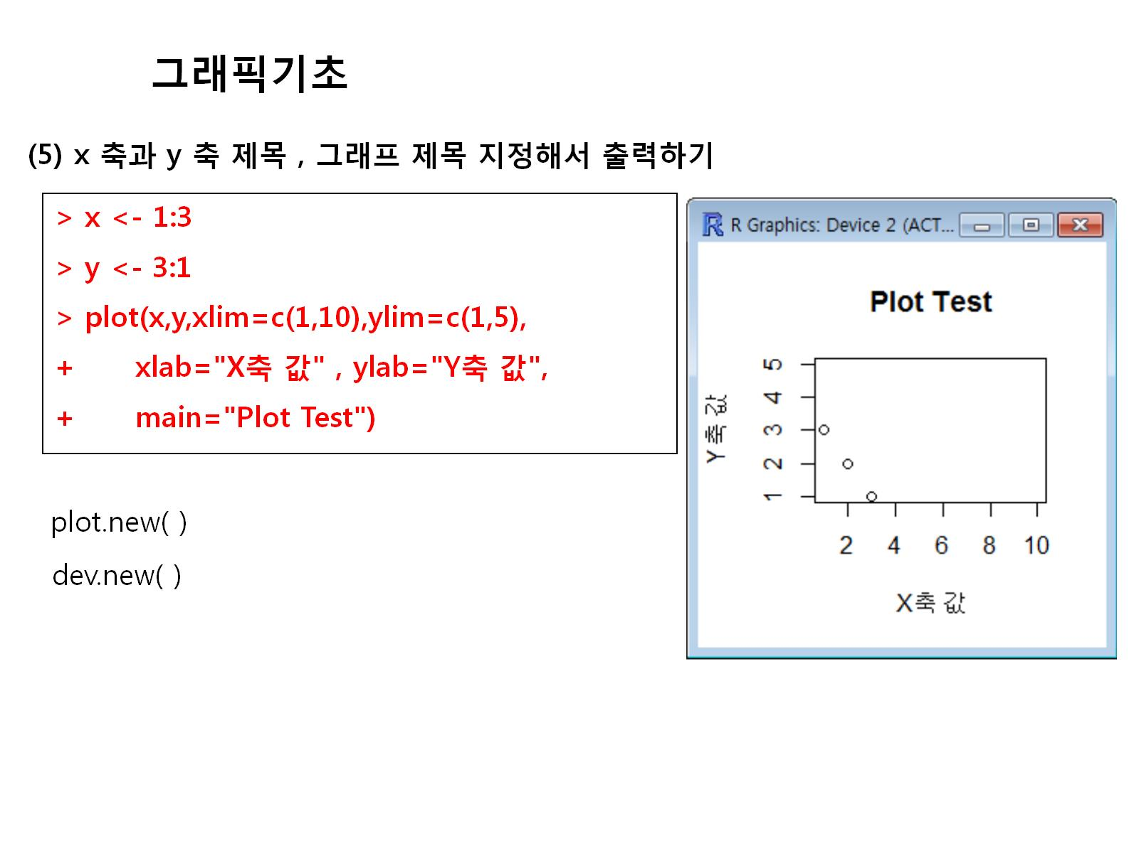

Slide 9
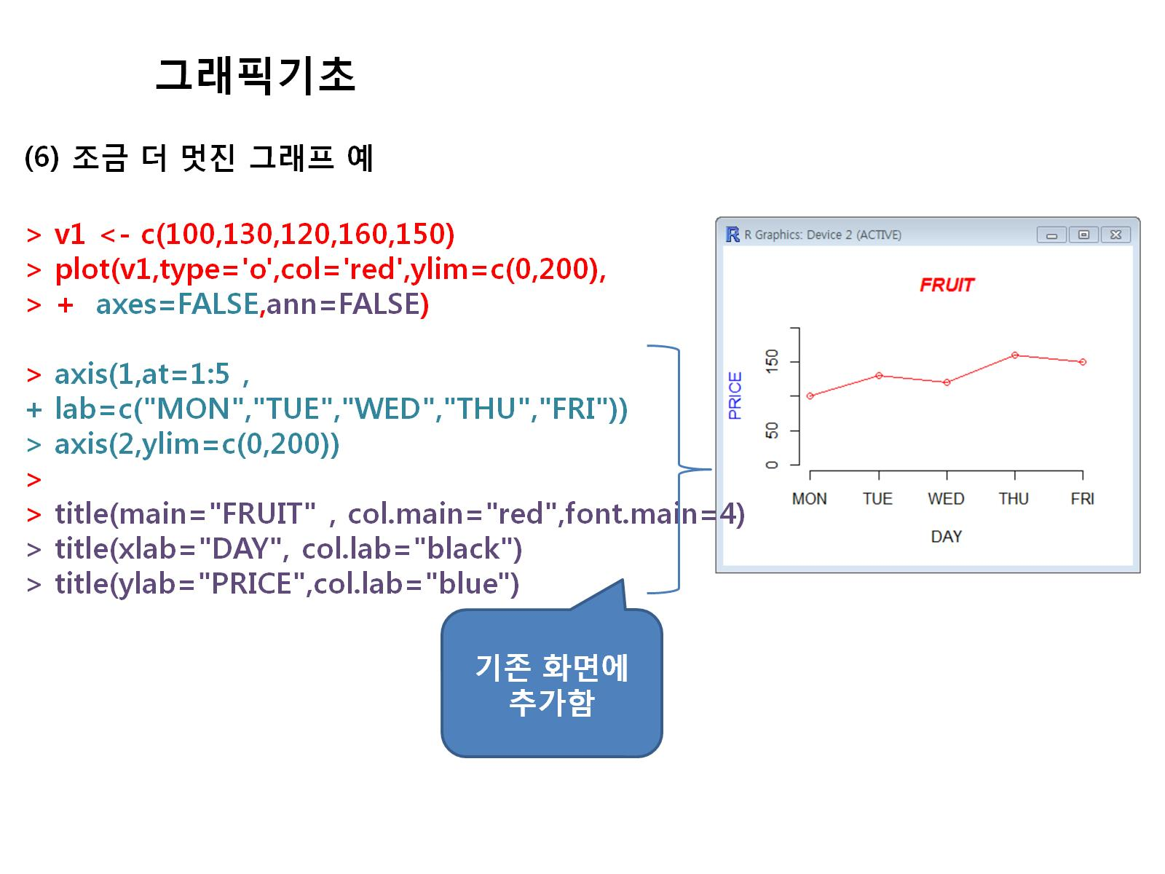

Slide 10
v1<-c(100,130,120,160,150)
plot(v1,type='o',col='red',ylim=c(0,200),axes = FALSE,ann=FALSE)
axis(1,at=1:5,
lab=c("MON","TUE","WED","THU","FRI"))
axis(2,ylim=c(0,200))
title(main="FRUIT",col.main="red",font.main=4)
title(xlab="DAY",col.lab="black")
title(ylab="PRICE",col.lab="blue")

Slide 11
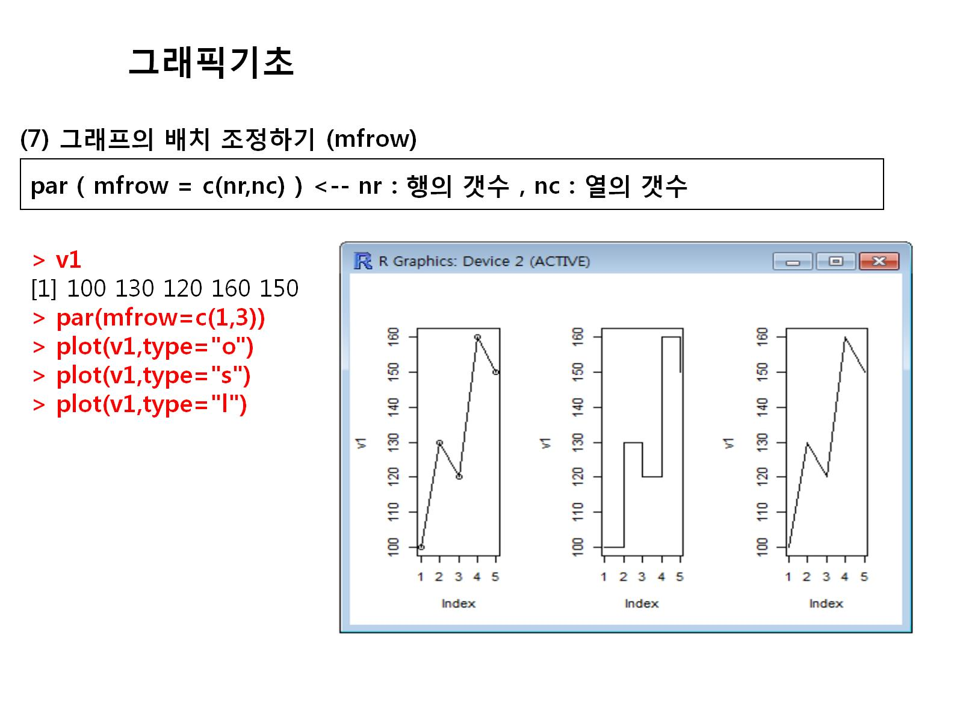

Slide 12
v1
par(mfrow=c(1,3))
plot(v1,type="o")
plot(v1,type="s")
plot(v1,type="l")

Slide 13
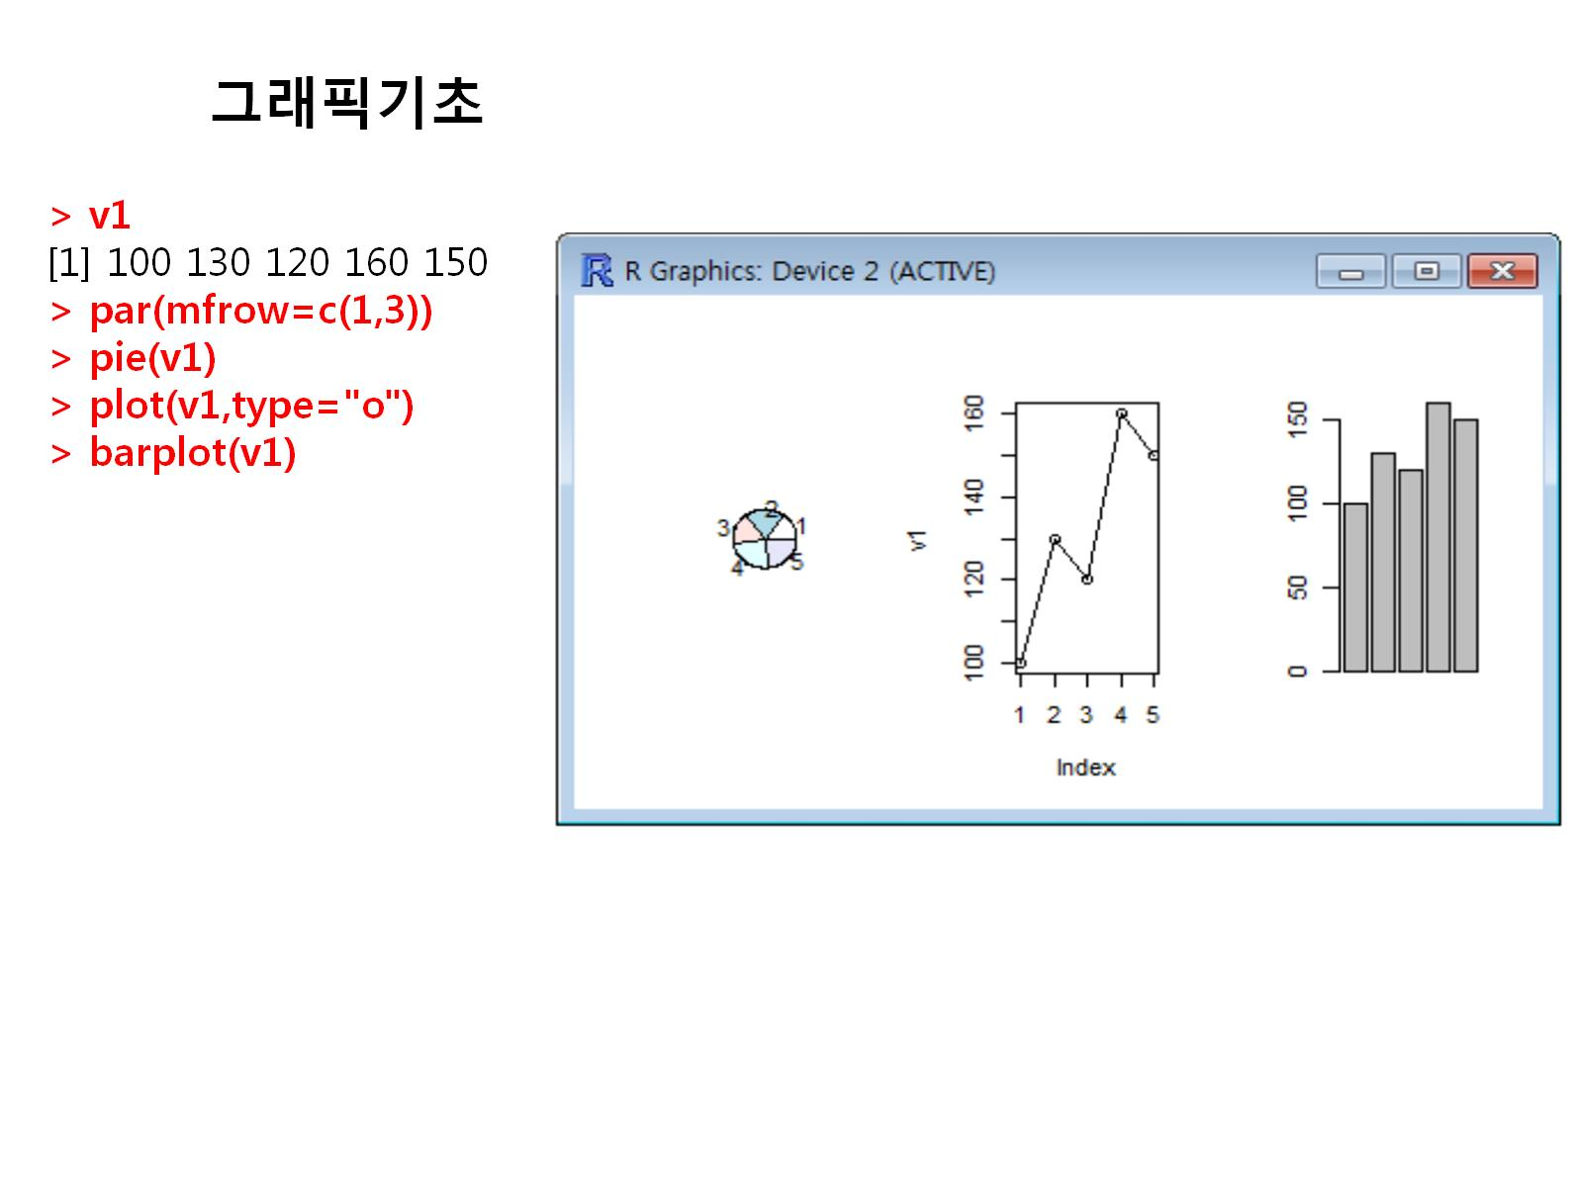

Slide 14
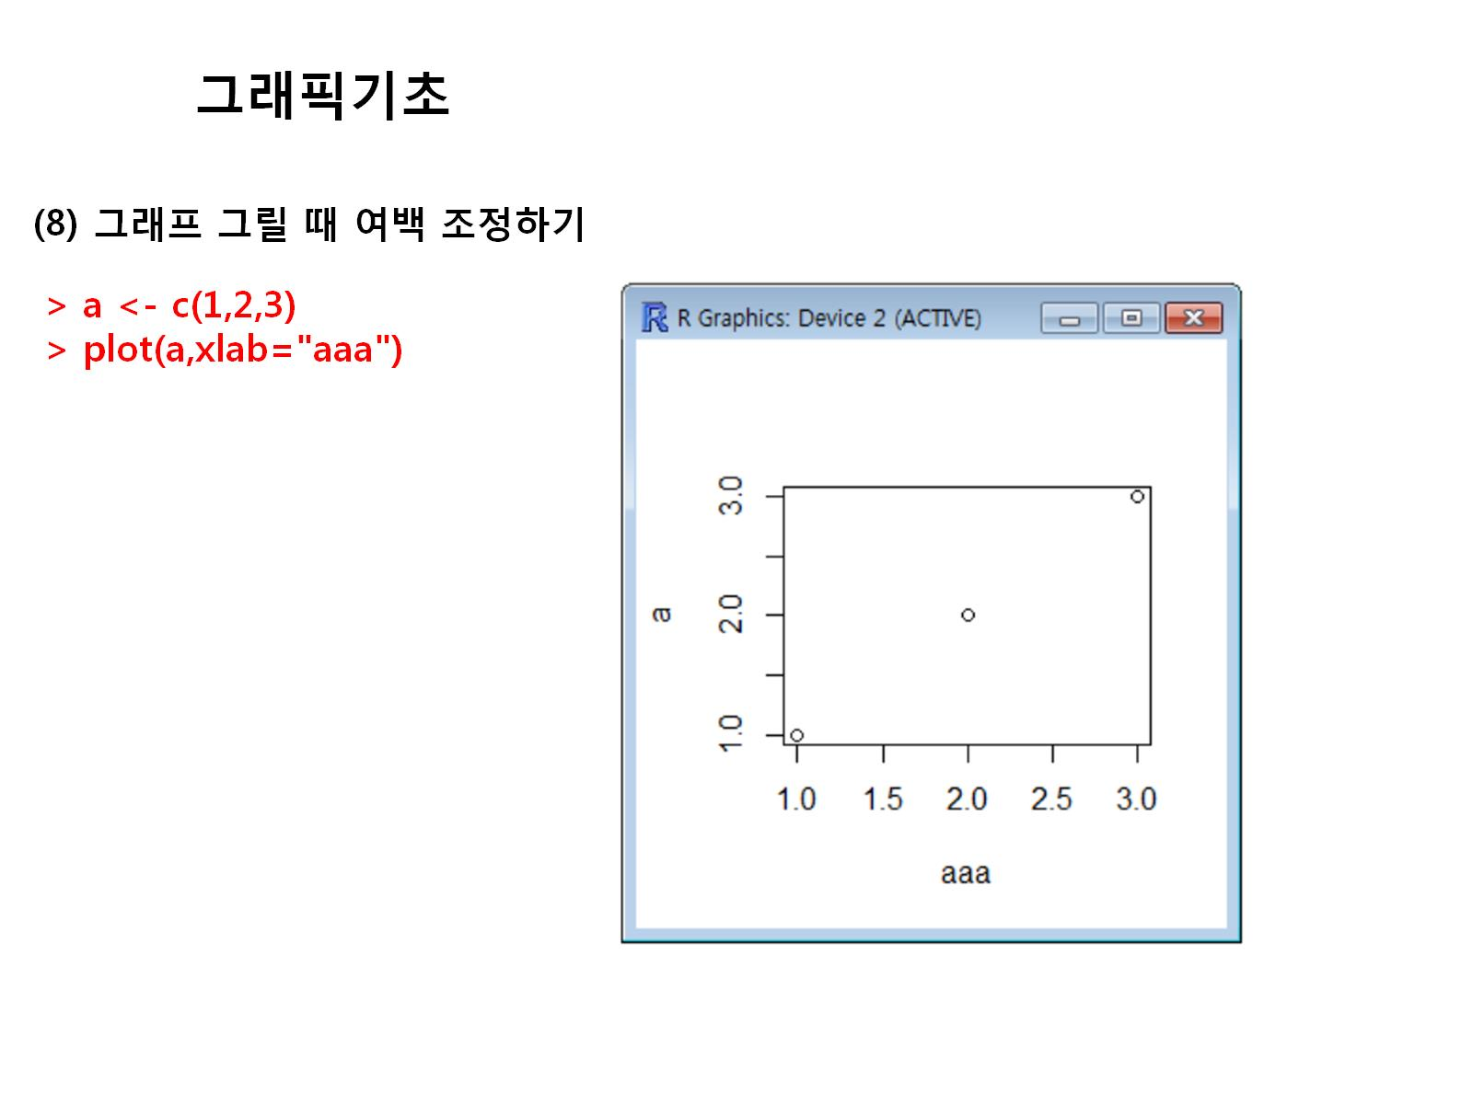

Slide 15
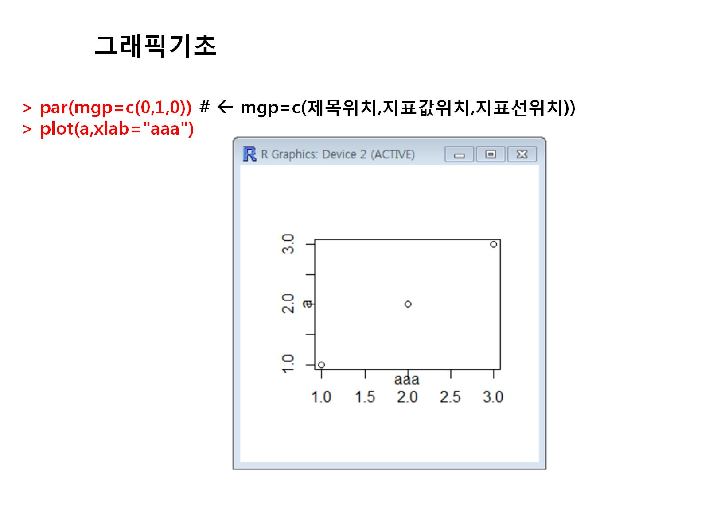

Slide 16
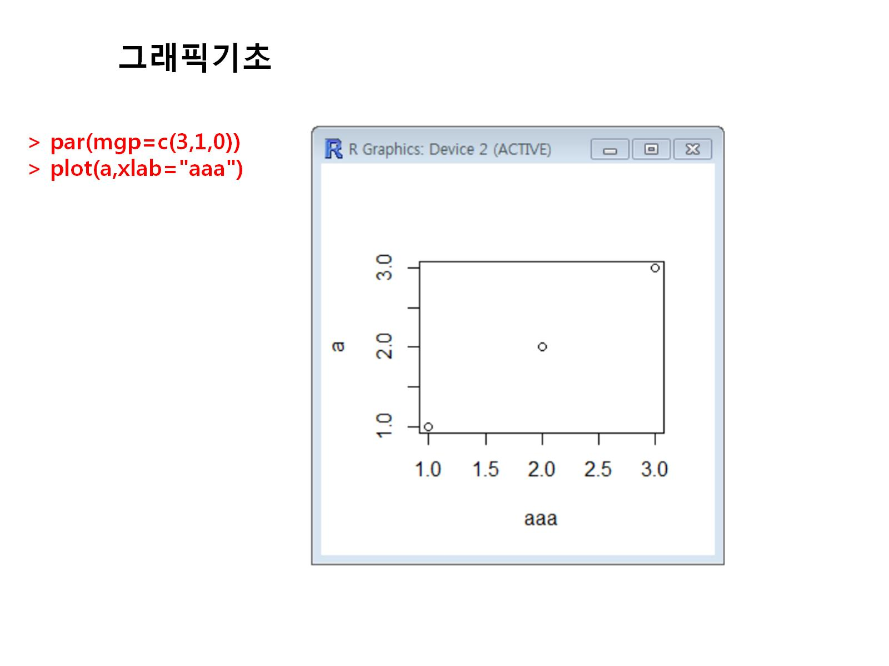

Slide 17
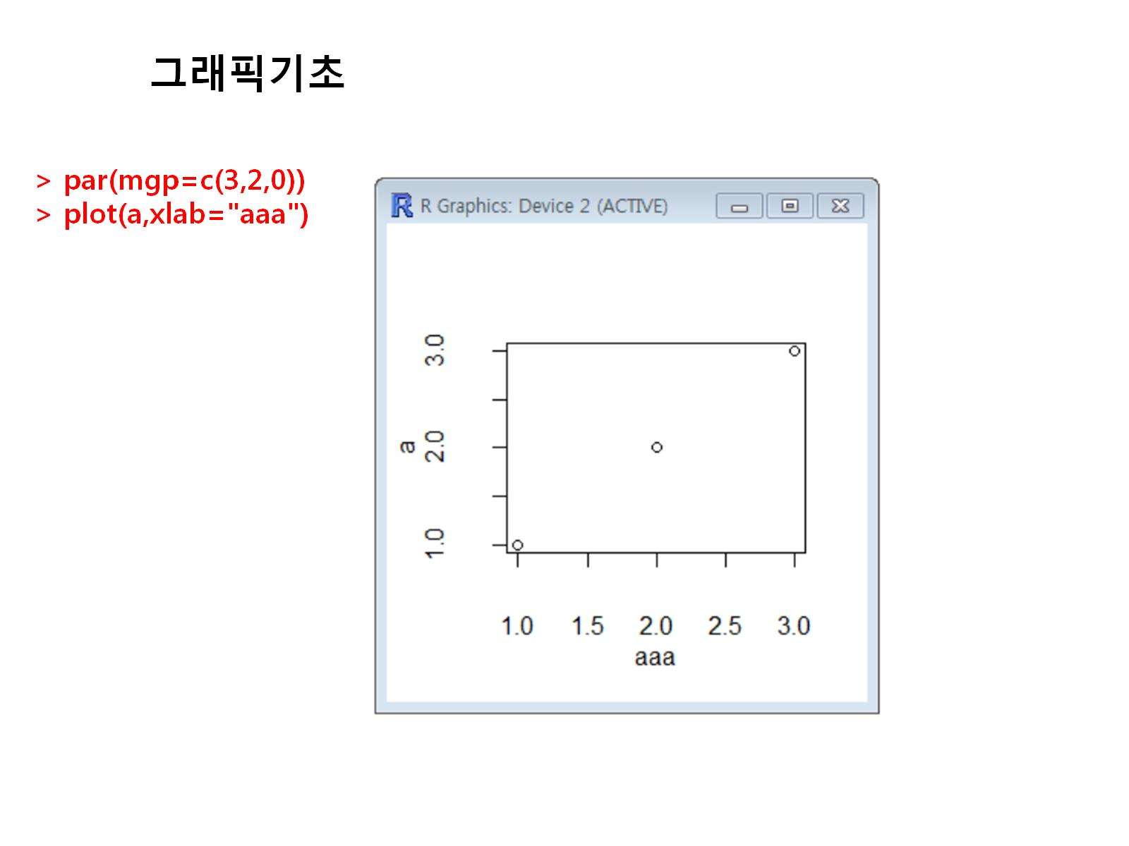

Slide 18
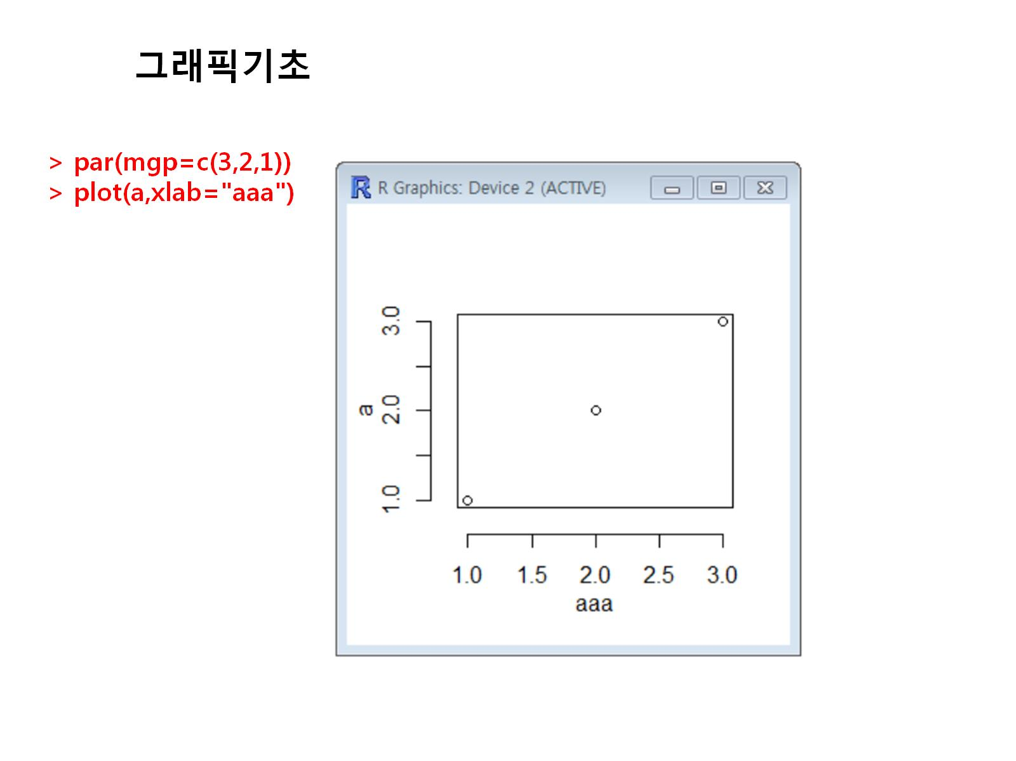

Slide 19
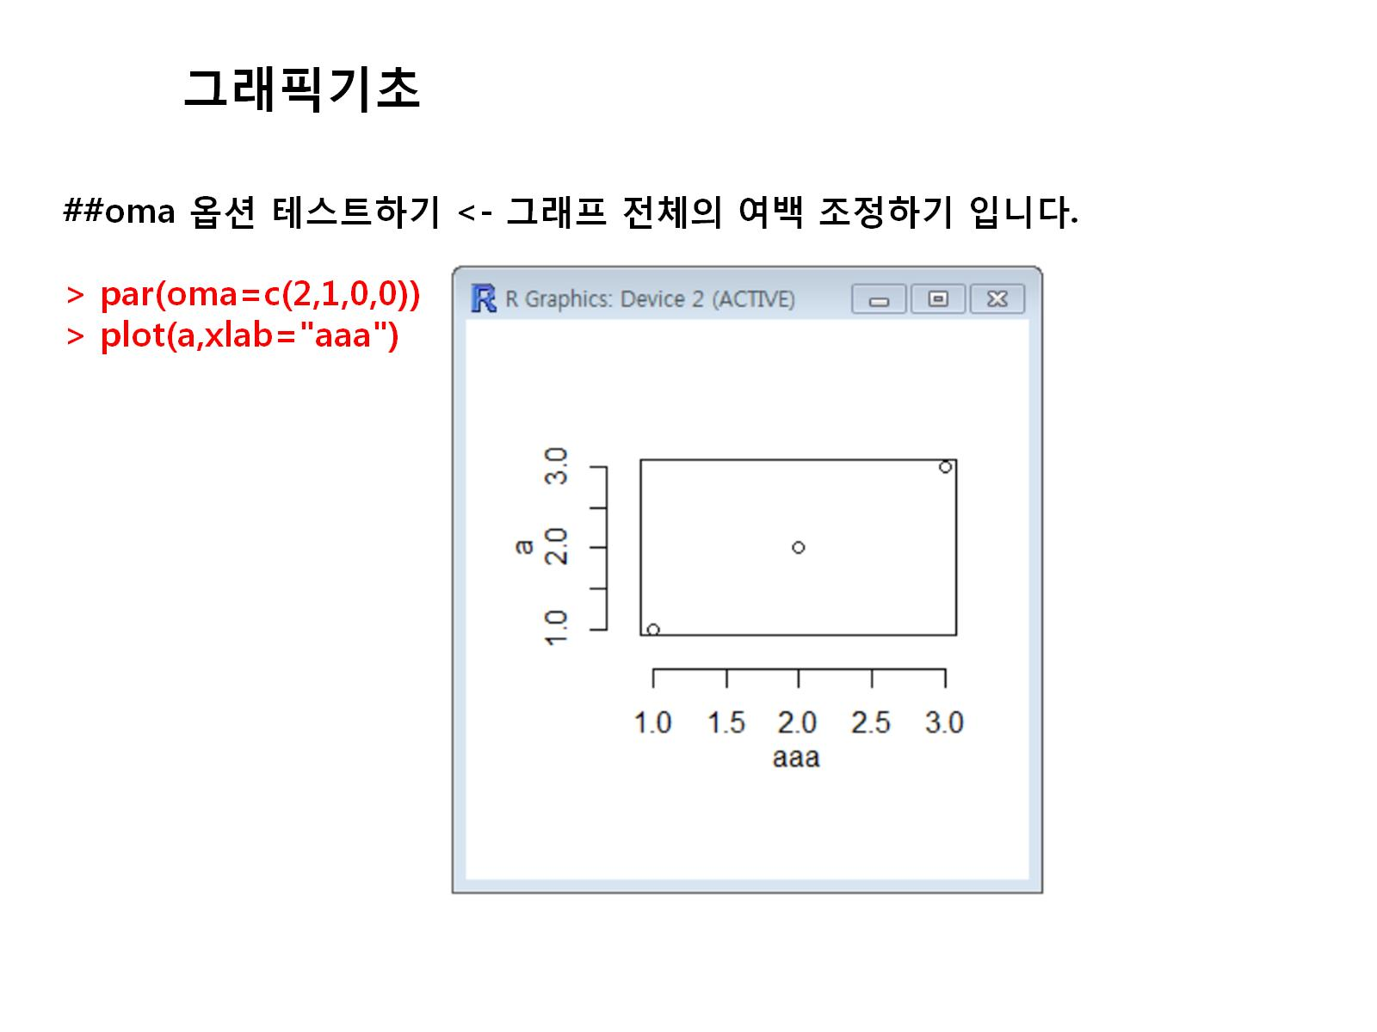

Slide 20
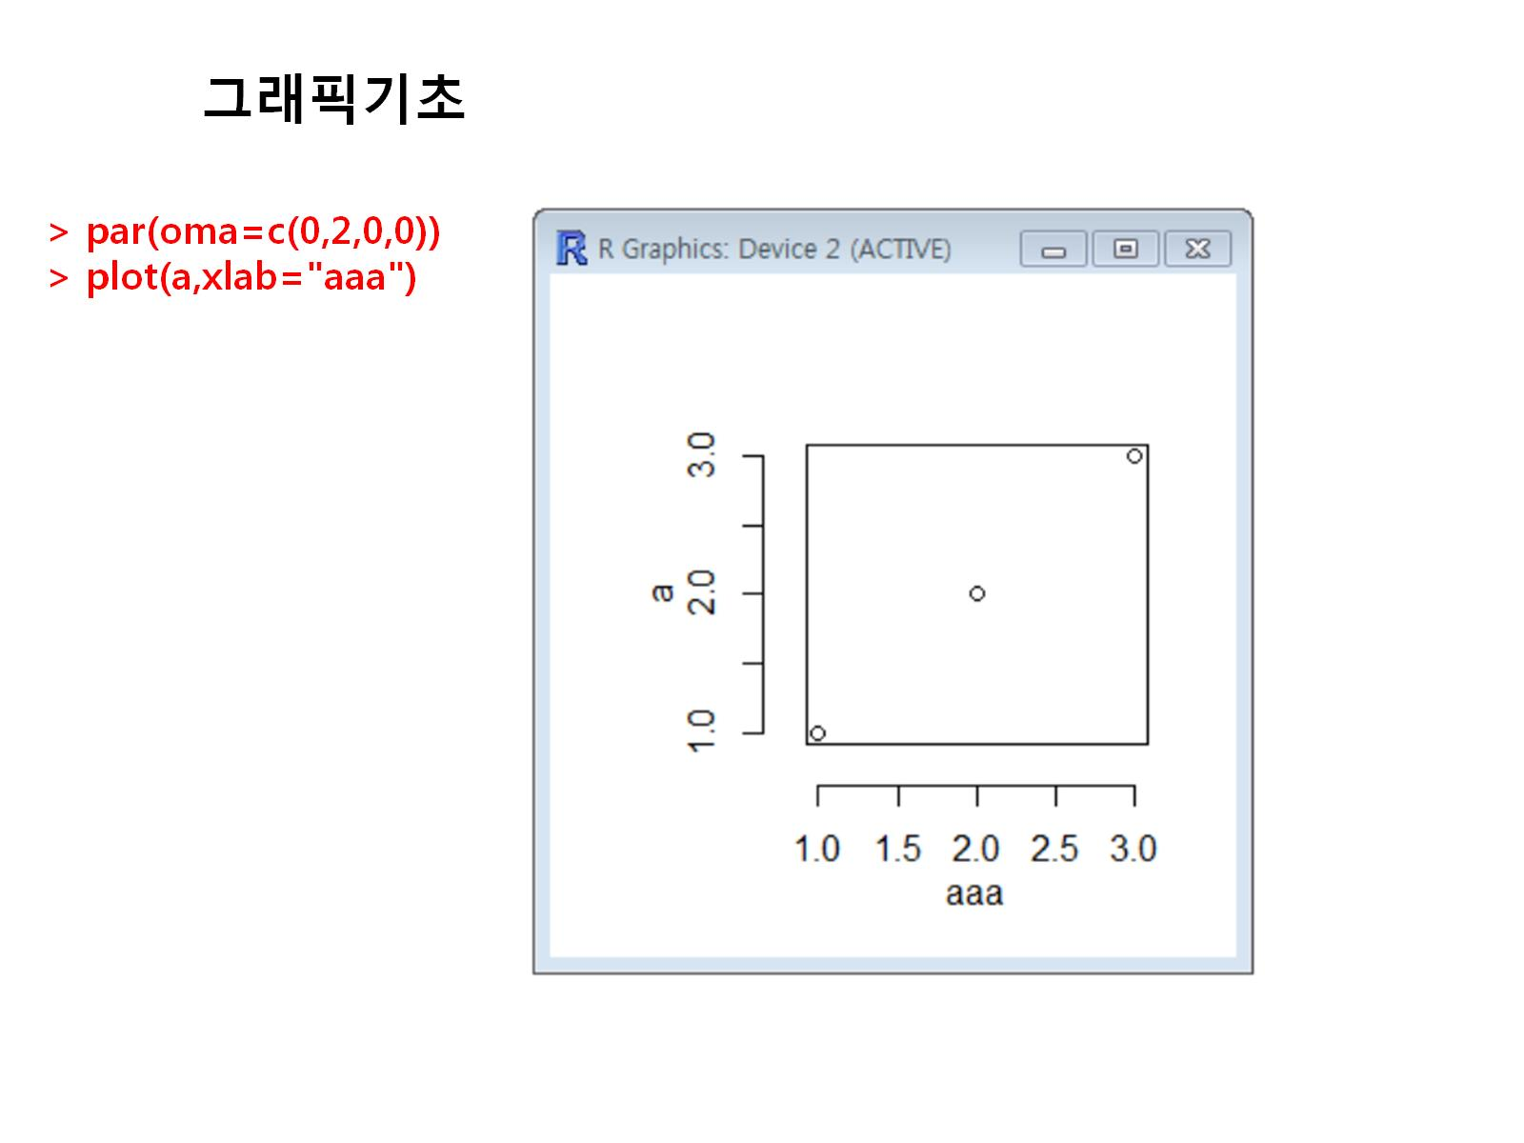

Slide 21
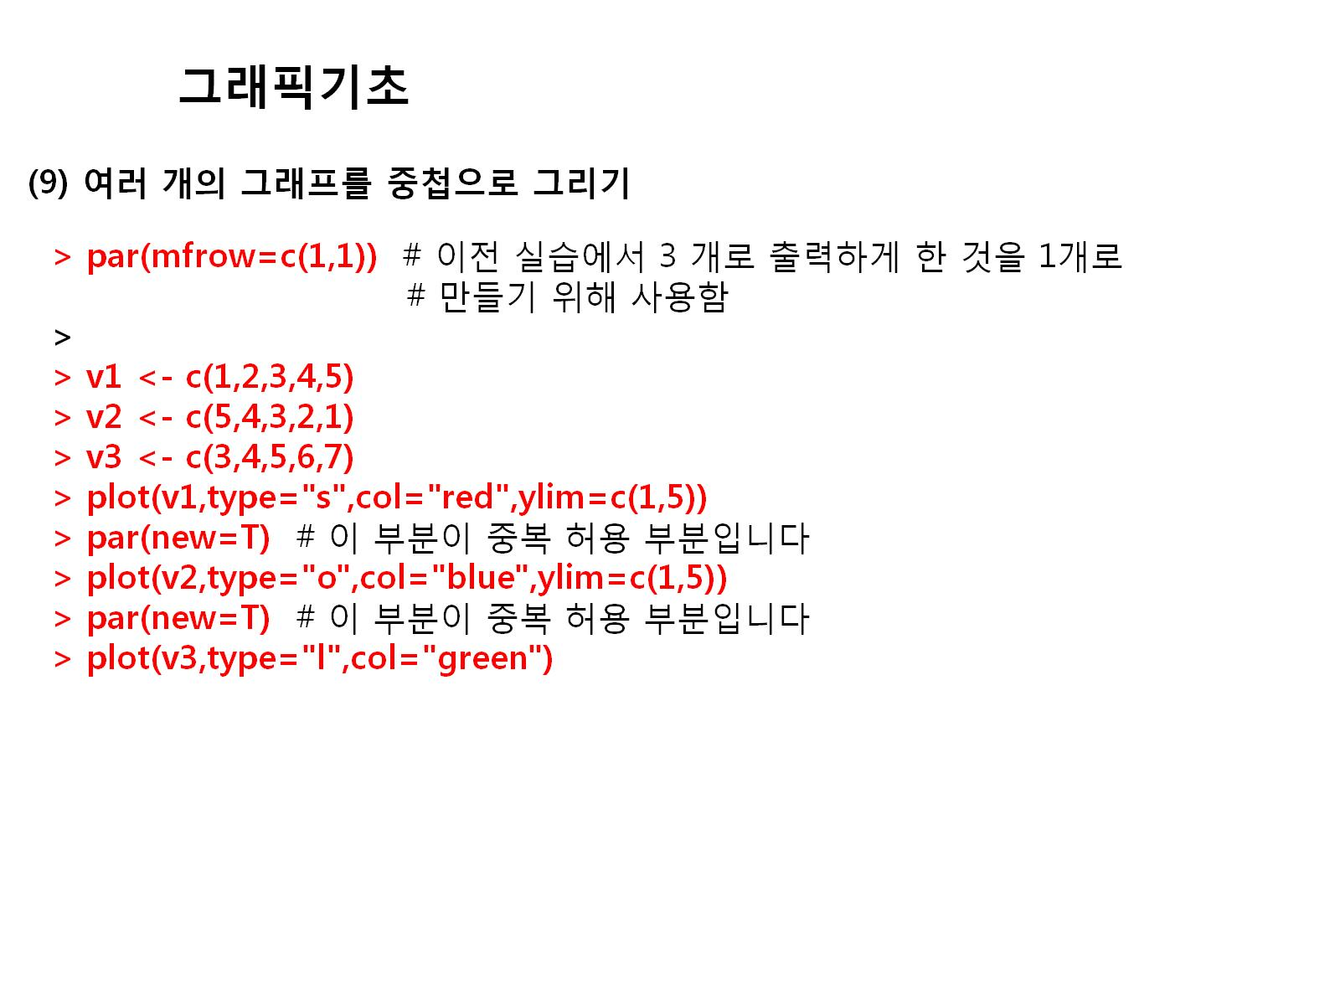

Slide 22
par(mfrow=c(1,1))
v1<-c(1,2,3,4,5)
v2<-c(5,4,3,2,1)
v3<-c(3,4,5,6,7)
plot(v1,type="S",col="red",ylim=c(1,5))
par(new=T)
plot(v2,type="o",col="blue",ylim=c(1,5))
par(new=T)
plot(v3,type="l",col="green")

Slide 23
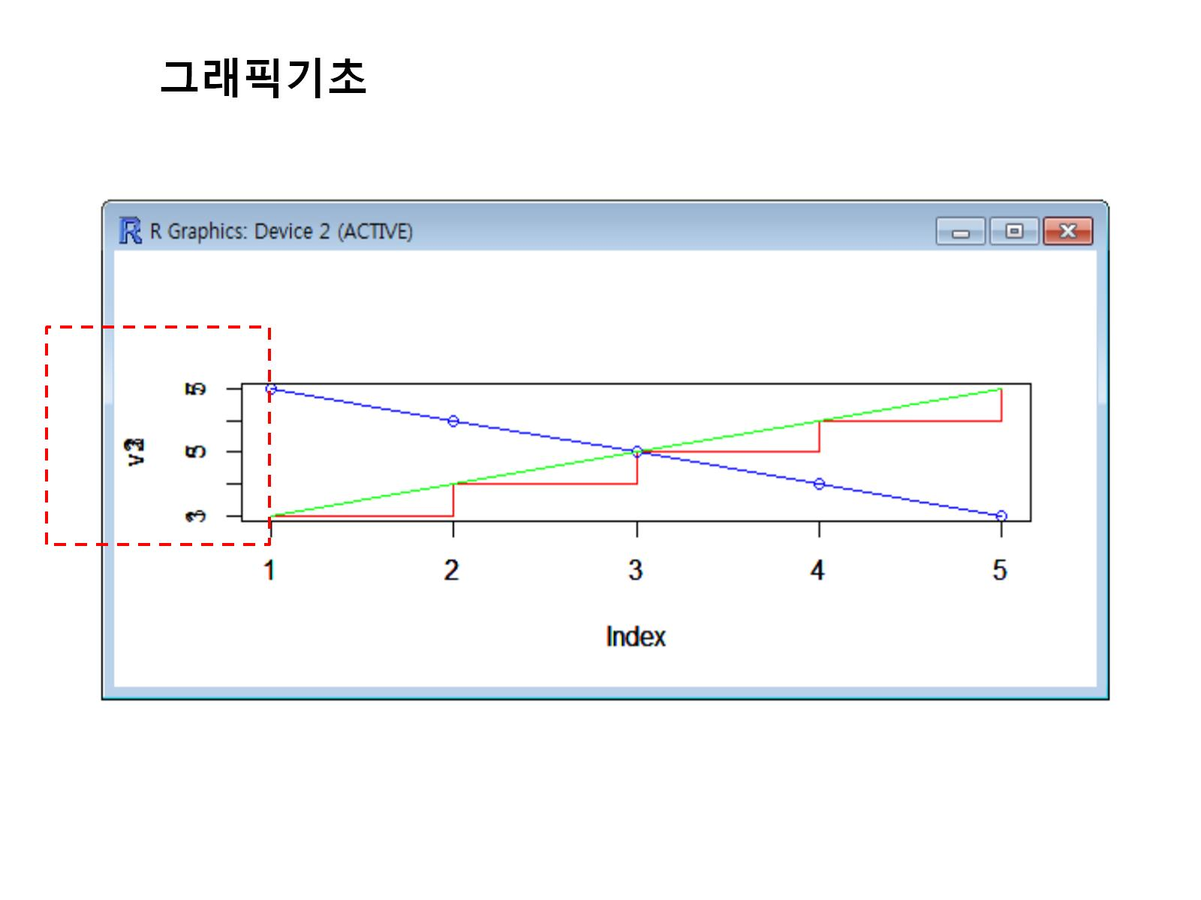

Slide 24
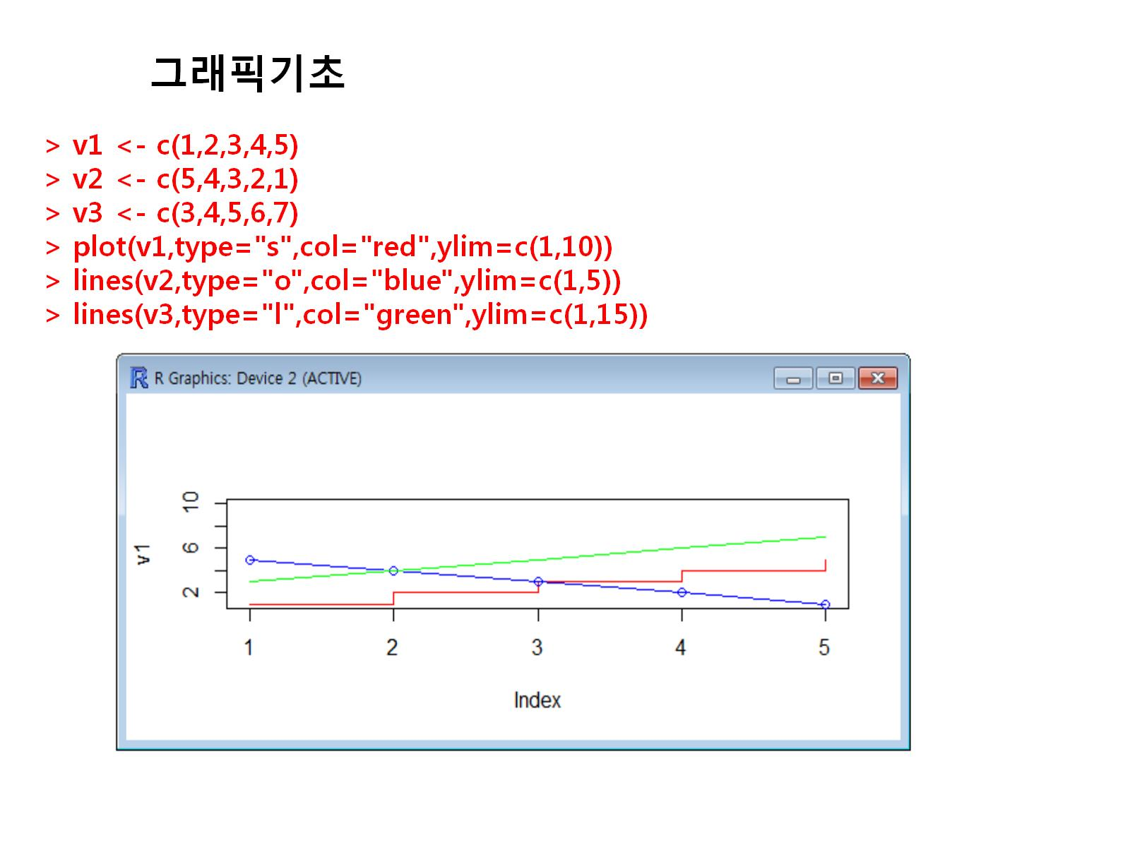

Slide 25
v1<-c(1,2,3,4,5)
v2<-c(5,4,3,2,1)
v3<-c(3,4,5,6,7)
plot(v1,type="S",col="red",ylim=c(1,10))
lines(v2,type="o",col="blue",ylim=c(1,5))
lines(v3,type="l",col="green",ylim=c(1,15))

Slide 26
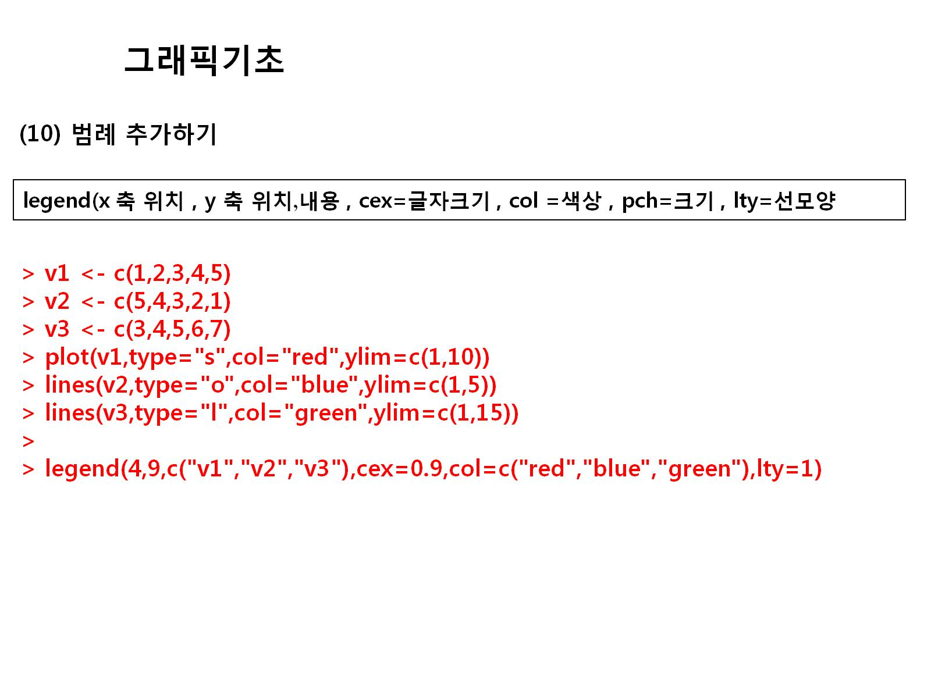

Slide 27
plot(v1,type="S",col="red",ylim=c(1,10))
lines(v2,type="o",col="blue",ylim=c(1,5))
lines(v3,type="l",col="green",ylim=c(1,15))
legend(4,9,c("v1","v2","v3"),cex=0.9,col=c("red","blue","green"),lty=1)

Slide 28
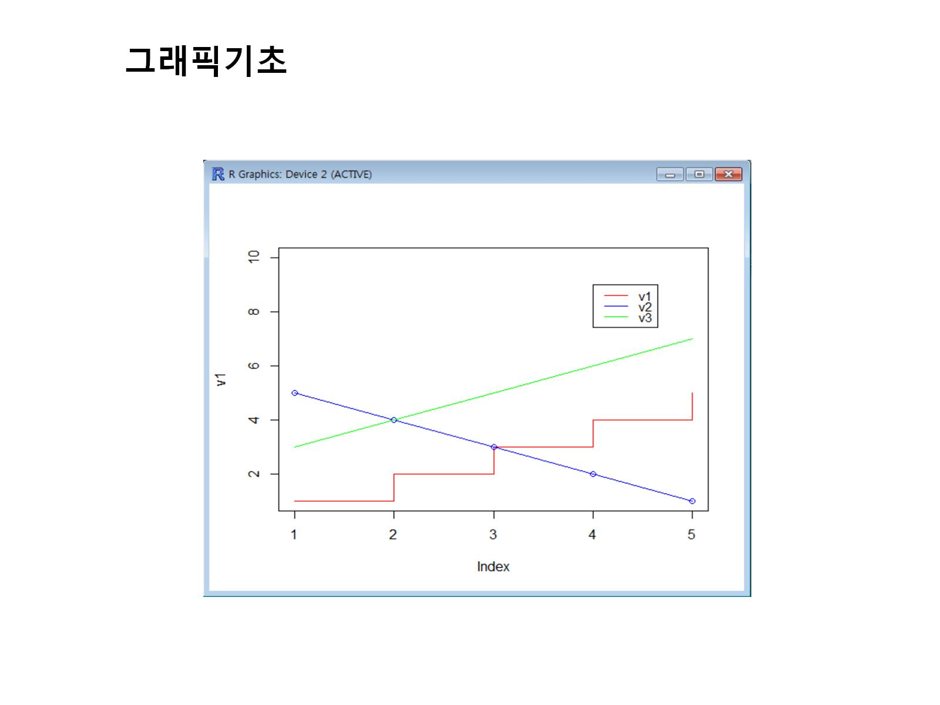

Slide 29
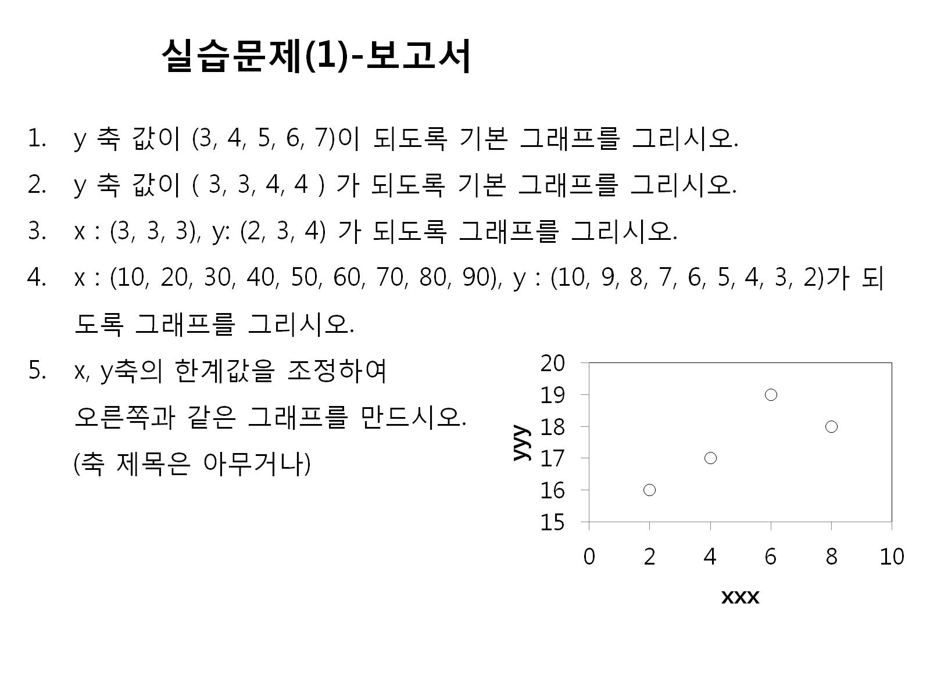

Slide 30
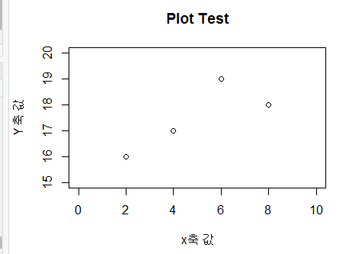
y<-c(3,4,5,6,7)
plot(y)
y<-c(2,2,2)
plot(y)
x<-c(3,3,3)
y<-2:4
plot(x,y)
x<-c(10,20,30,40,50,60,70,80,90)
y<-10:2
plot(x,y)
x<-c(2,4,6,8)
y<-c(16,17,19,18)
plot(x,y,xlim=c(0,10),ylim = c(15,20),
xlab="x축 값",ylab="Y축 값",
main="Plot Test")

Slide 31
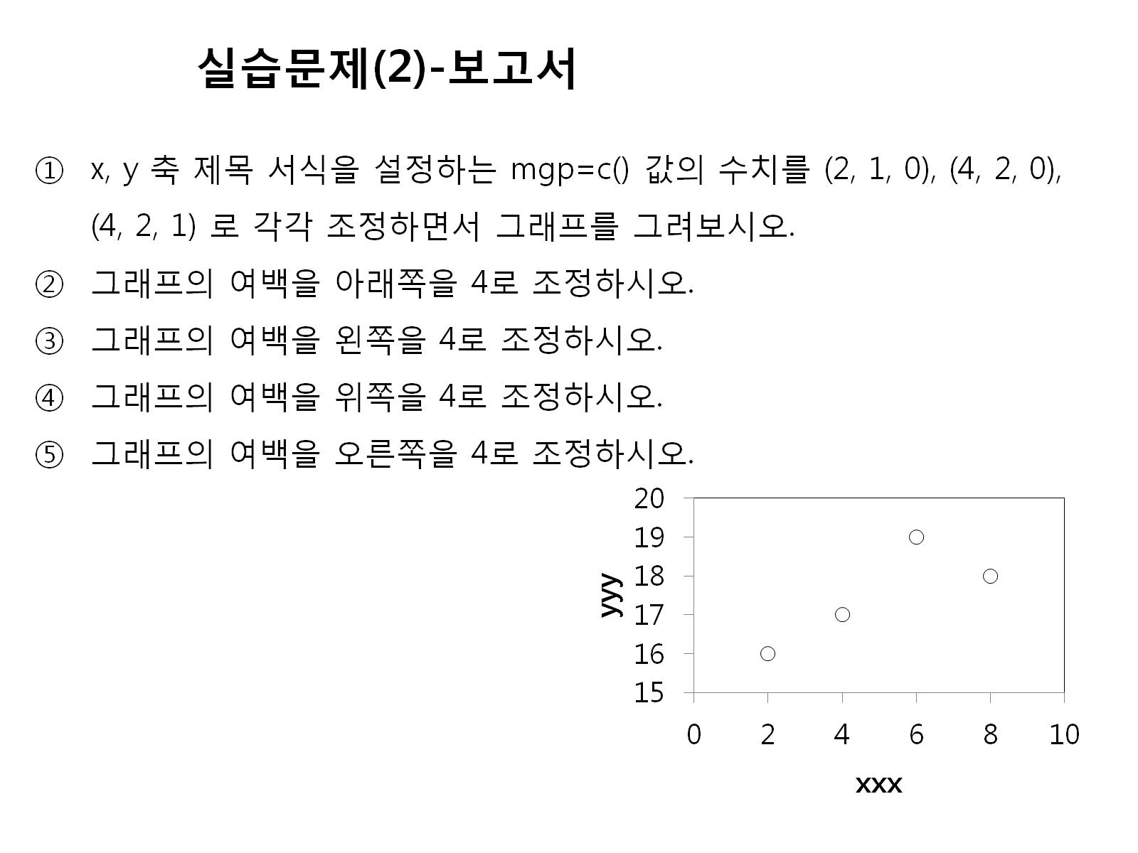

Slide 32
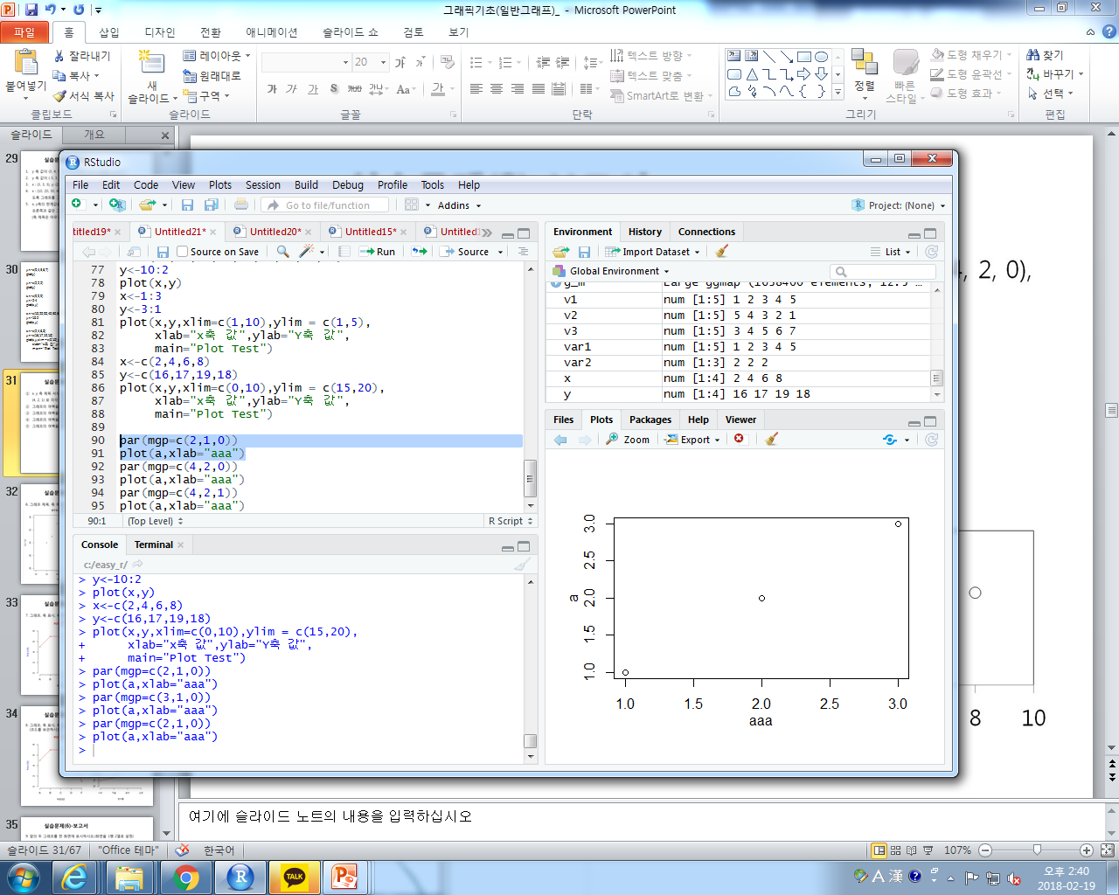
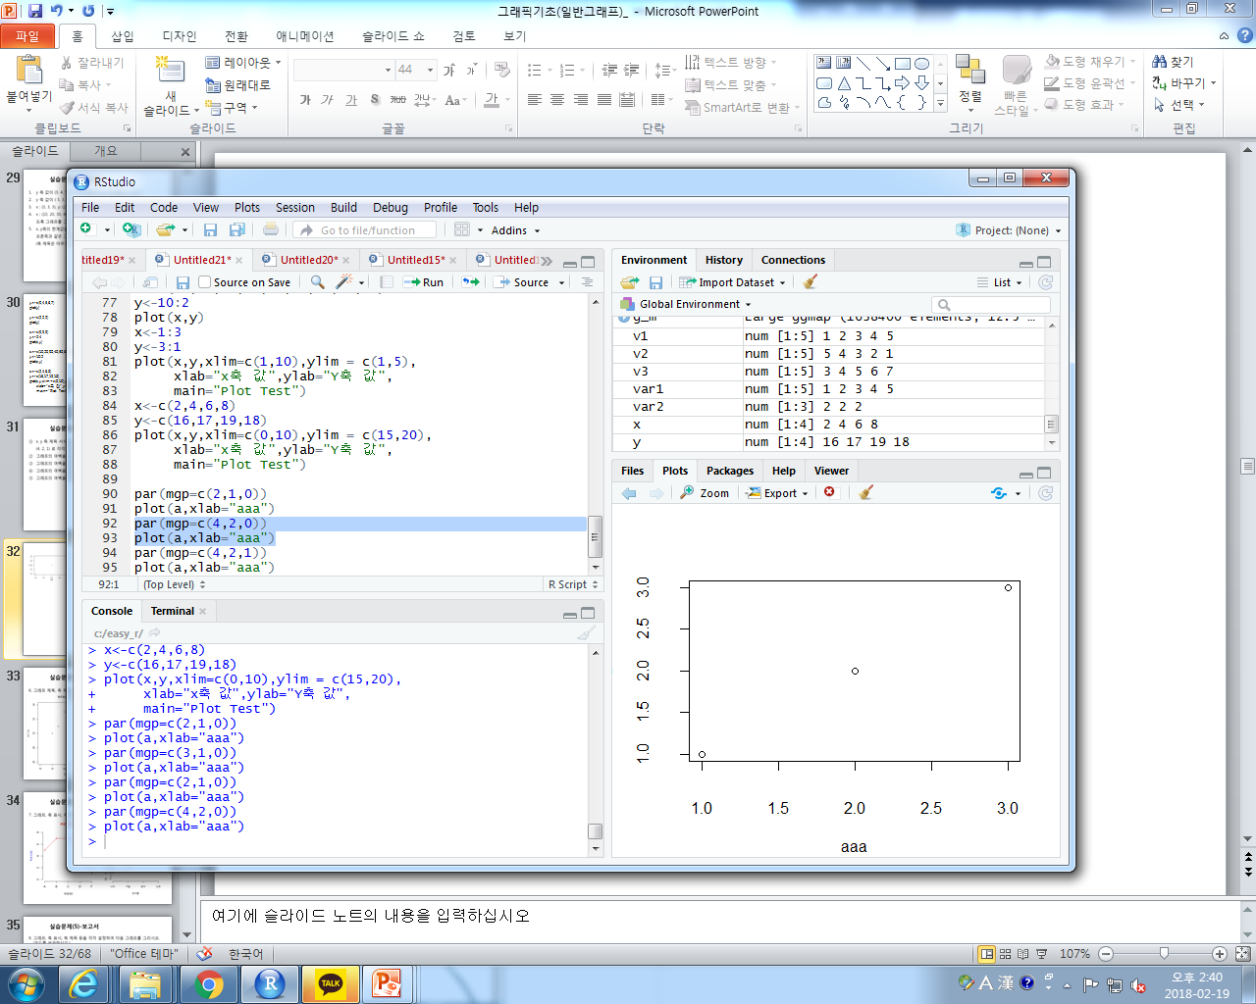
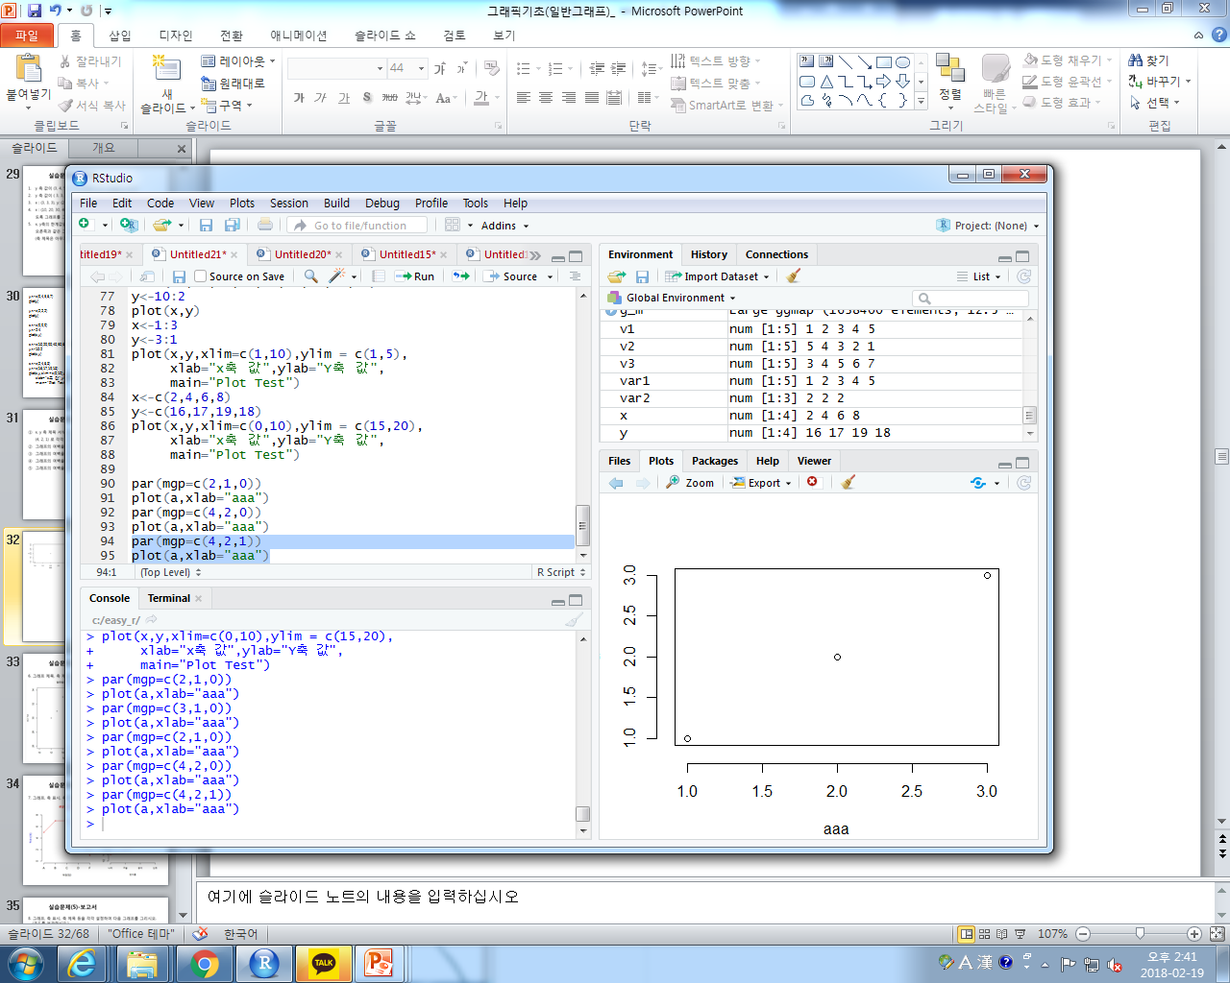
par(mgp=c(2,1,0))
plot(a,xlab="aaa")
par(mgp=c(4,2,0))
plot(a,xlab="aaa")
par(mgp=c(4,2,1))
plot(a,xlab="aaa")

Slide 33
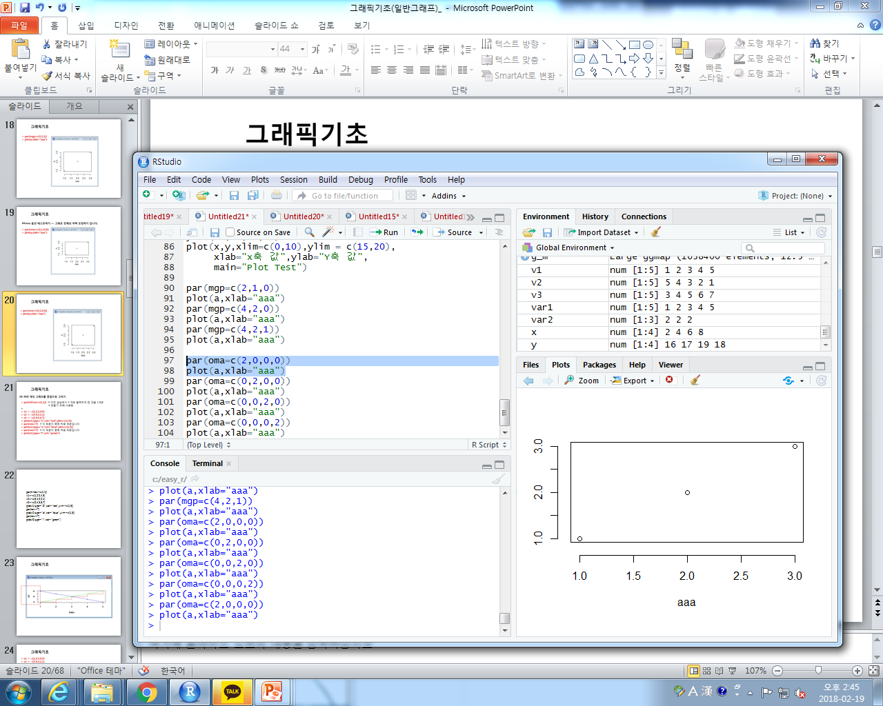
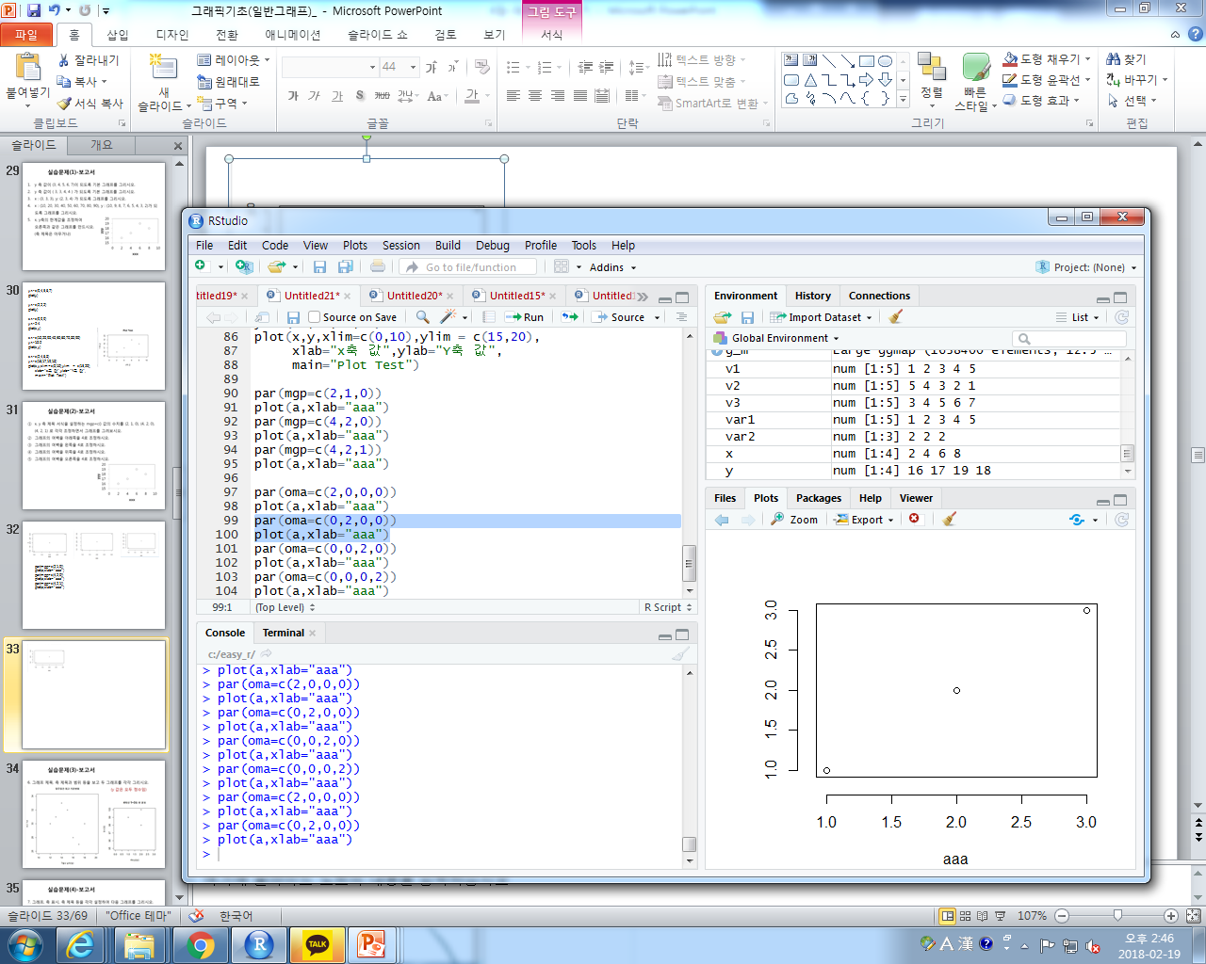
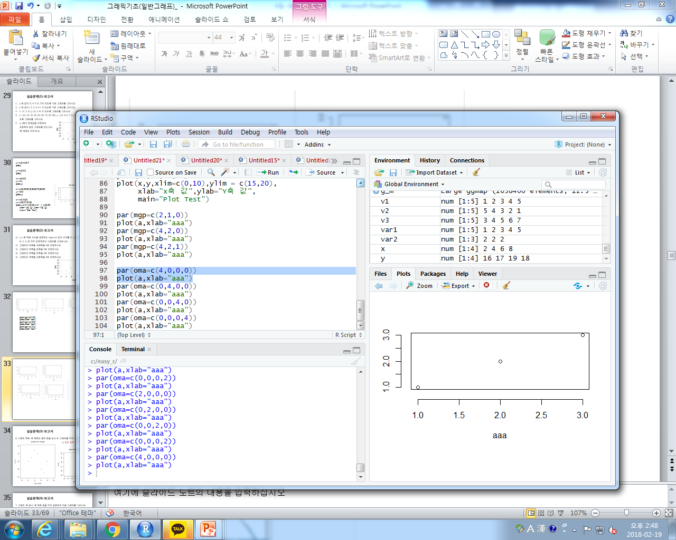
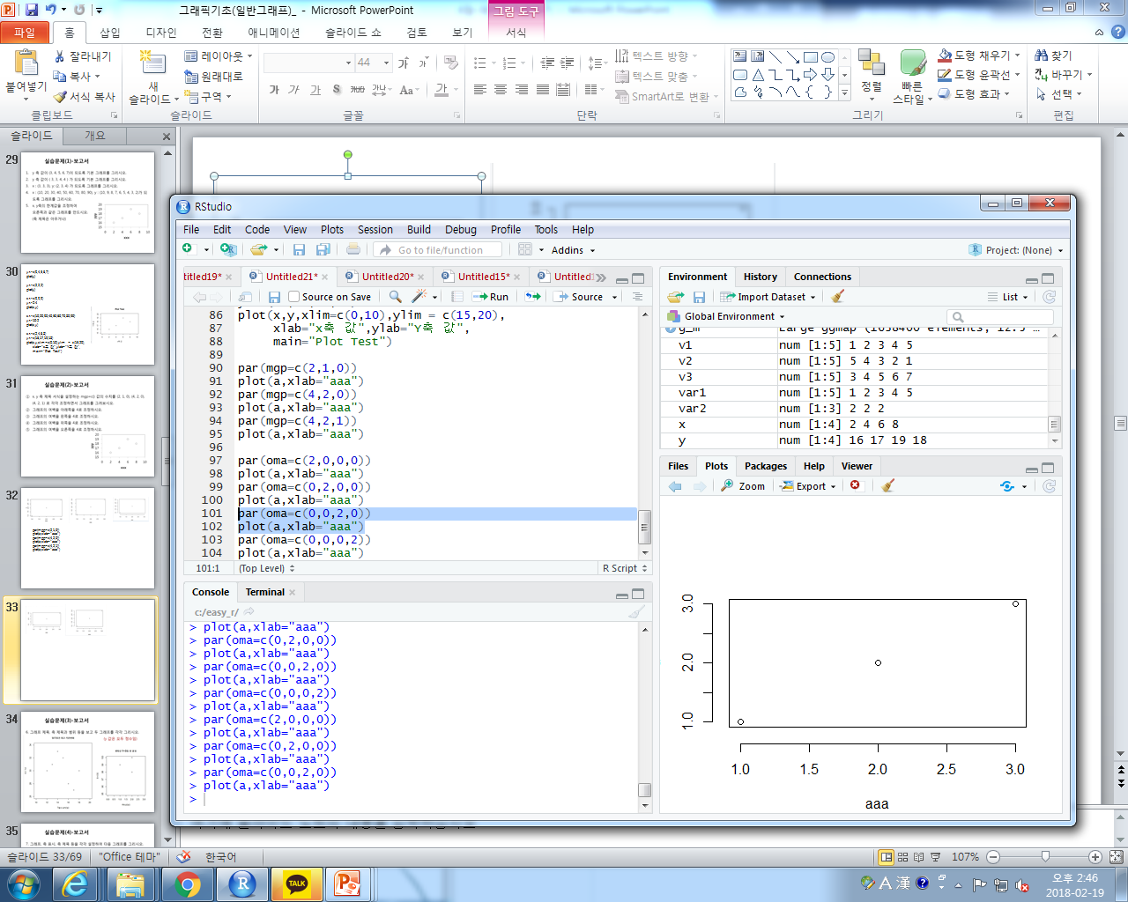
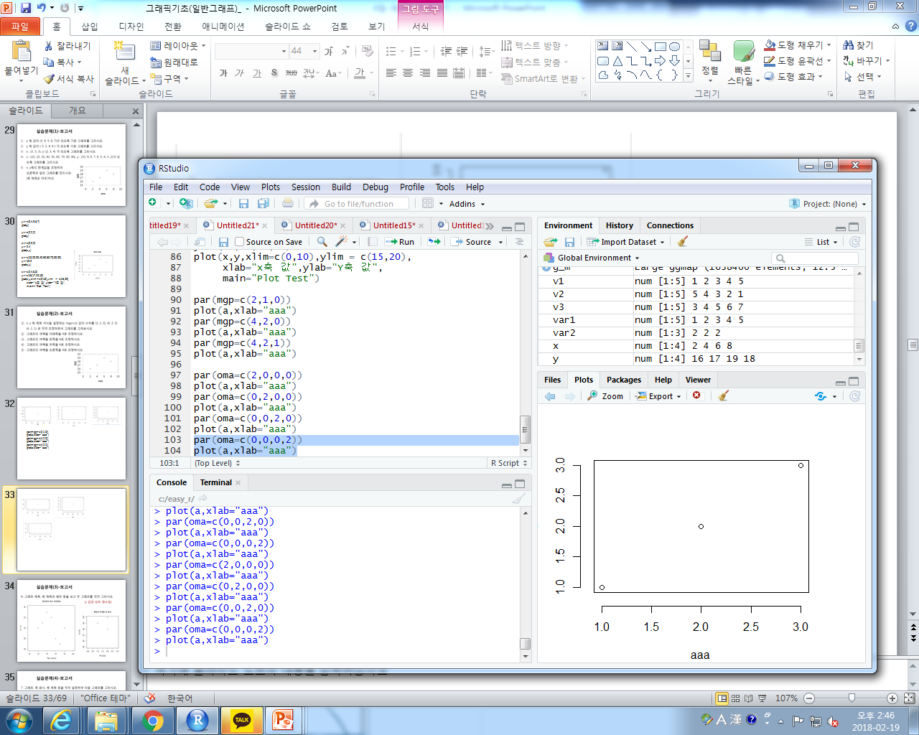
par(oma=c(4,0,0,0))
plot(a,xlab="aaa")
par(oma=c(0,4,0,0))
plot(a,xlab="aaa")
par(oma=c(0,0,4,0))
plot(a,xlab="aaa")
par(oma=c(0,0,0,4))
plot(a,xlab="aaa")

Slide 34
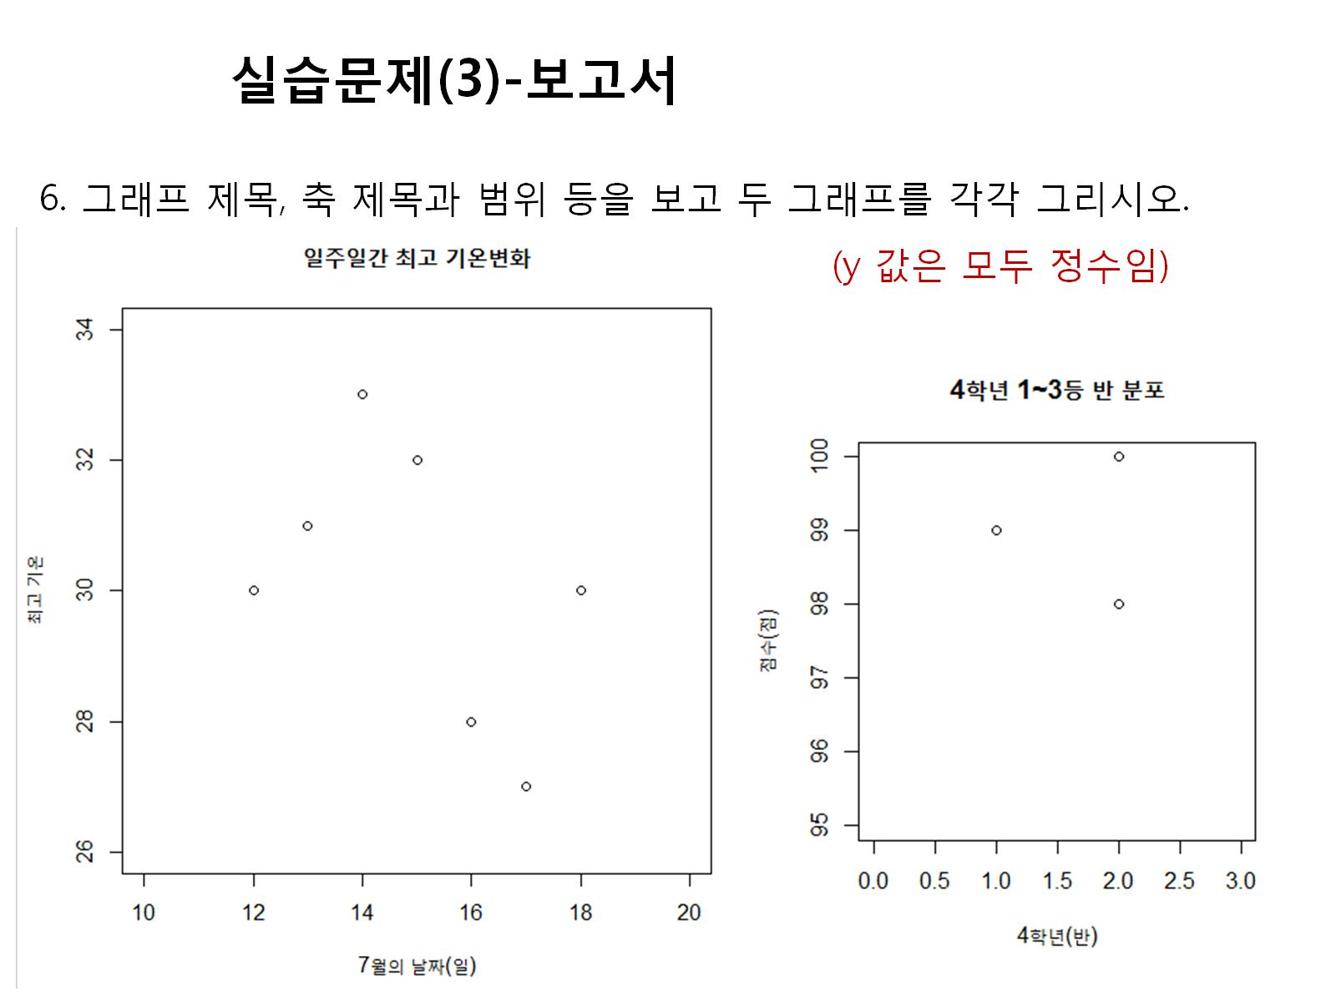

Slide 35
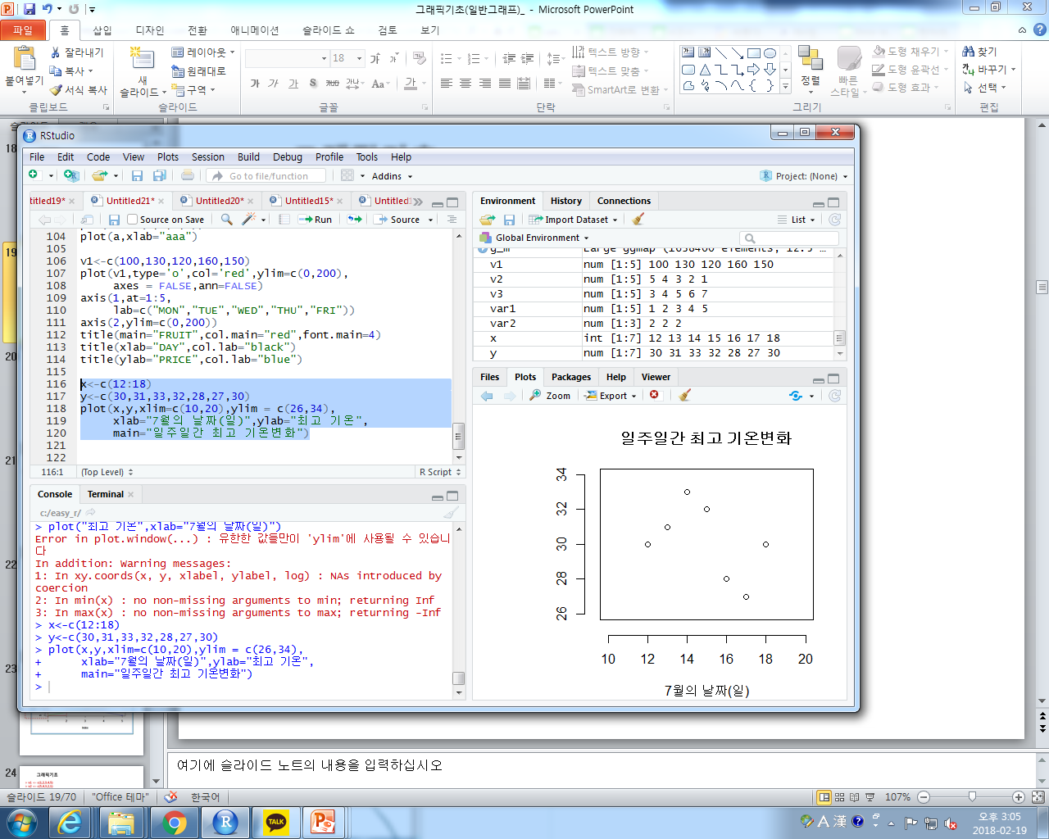
x<-c(12:18)
y<-c(30,31,33,32,28,27,30)
plot(x,y,xlim=c(10,20),ylim = c(26,34),
xlab="7월의 날짜(일)",ylab="최고 기온",
main="일주일간 최고 기온변화")
x<-c(1.0,2.0,2.0)
y<-c(99,98,100)
plot(x,y,xlim=c(0.0,3.0),ylim = c(95,100),
xlab="4학년(반)",ylab="점수(점)",
main="4학년 1~3등 반 분포")

Slide 36
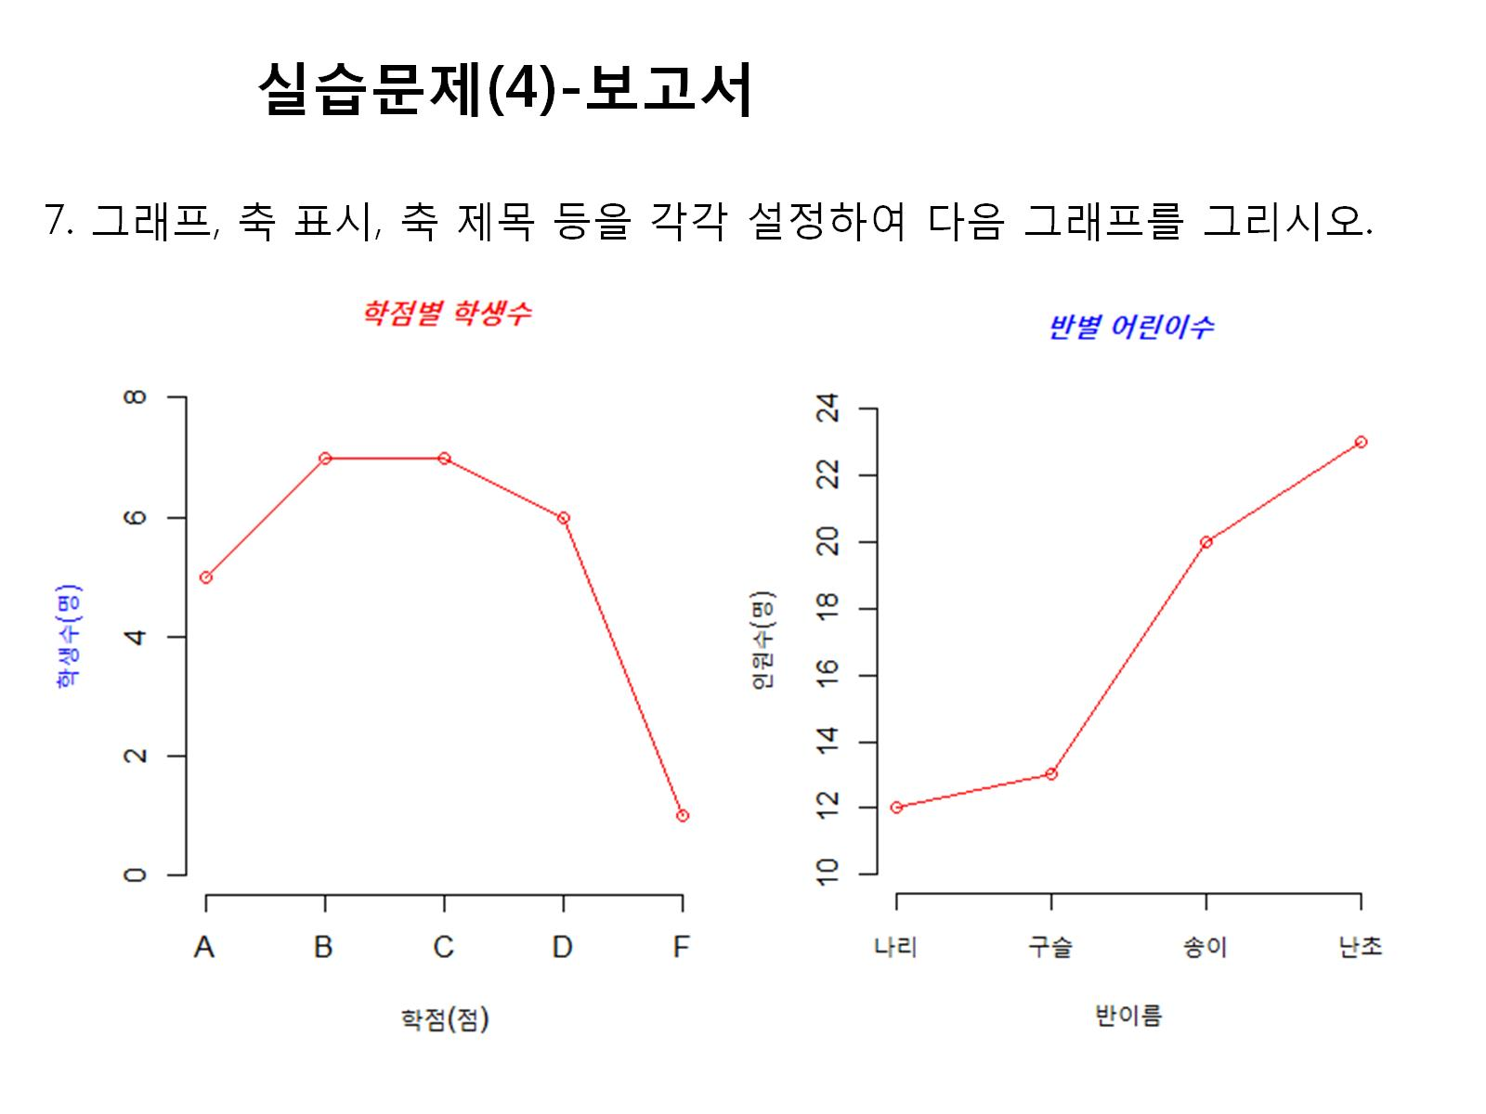

Slide 37
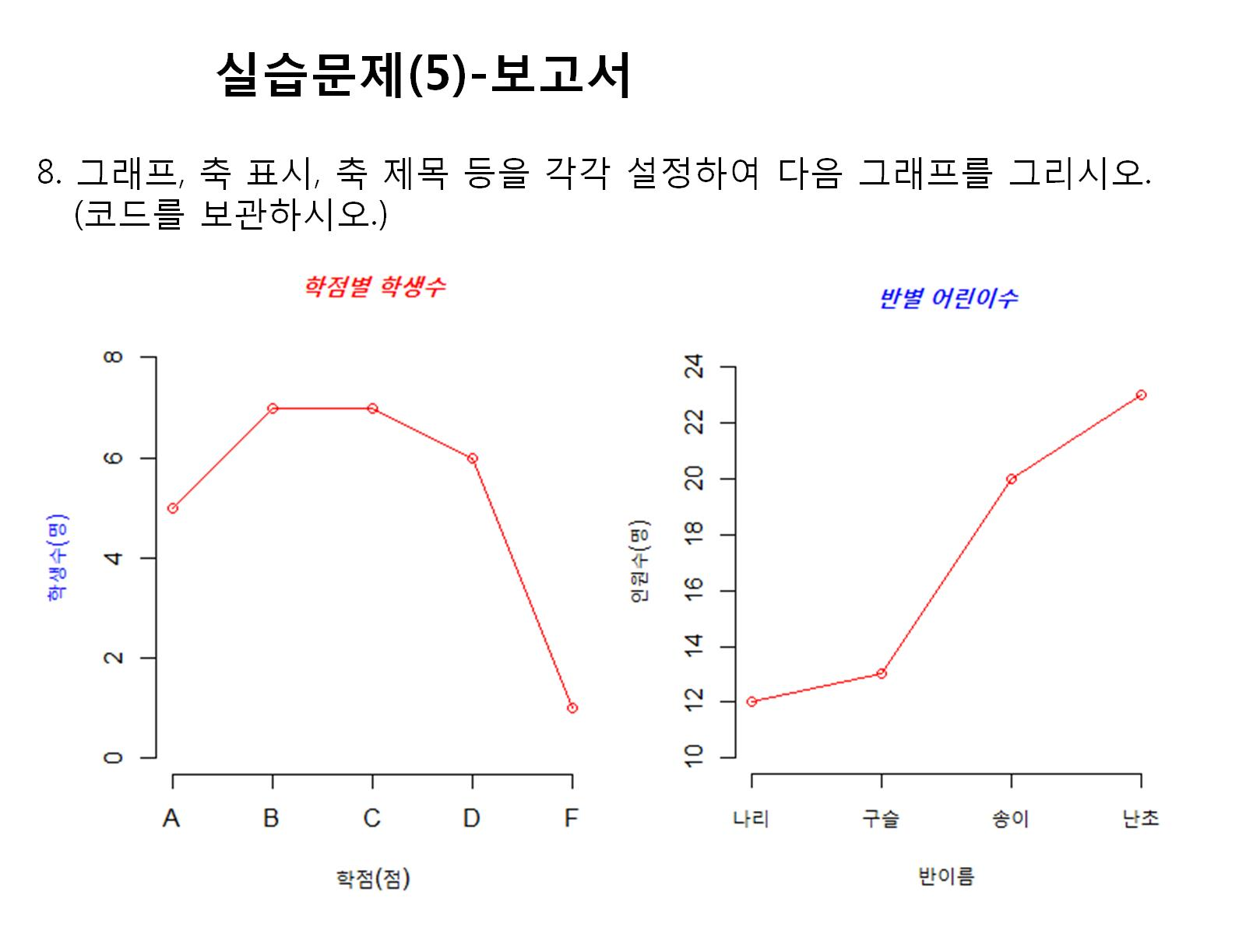

Slide 38
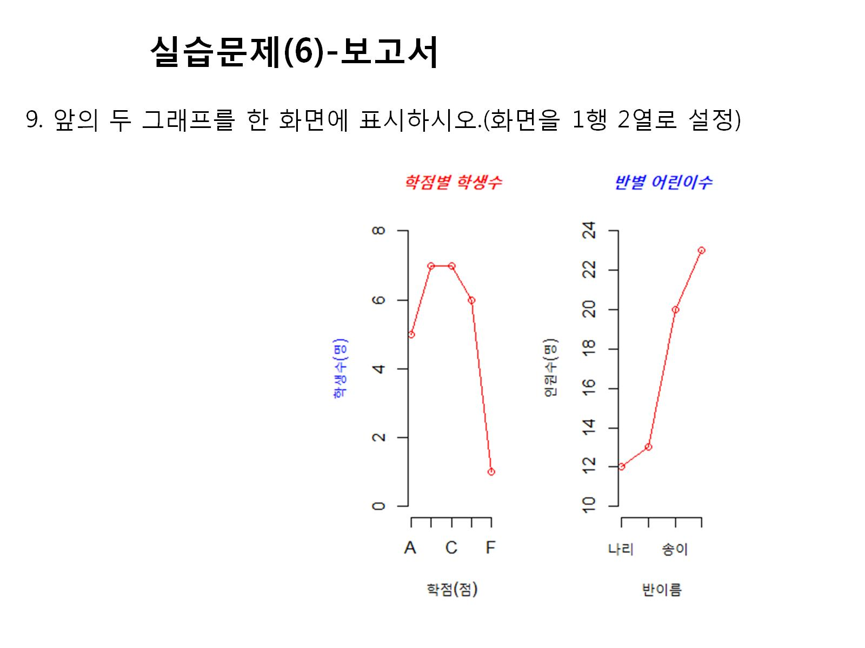

Slide 39
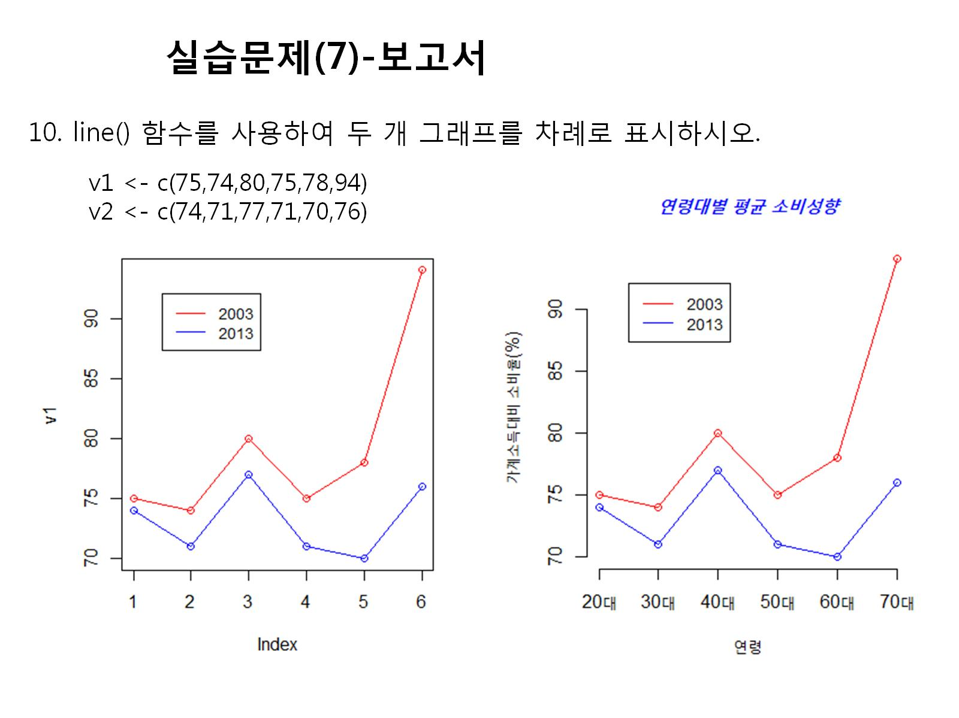

Slide 40
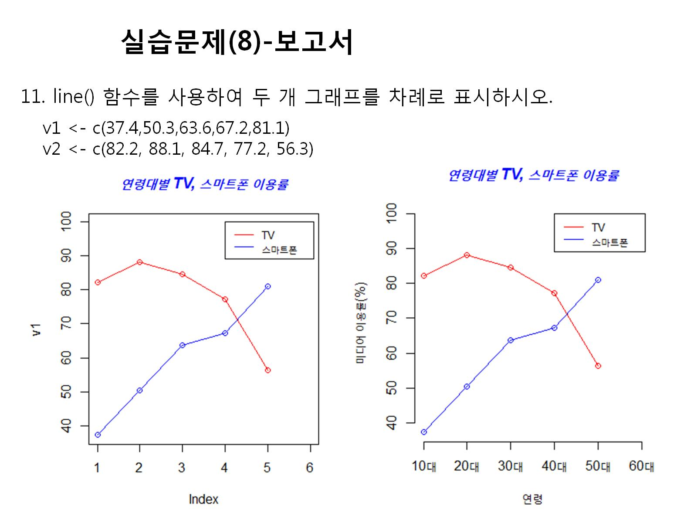

Slide 41
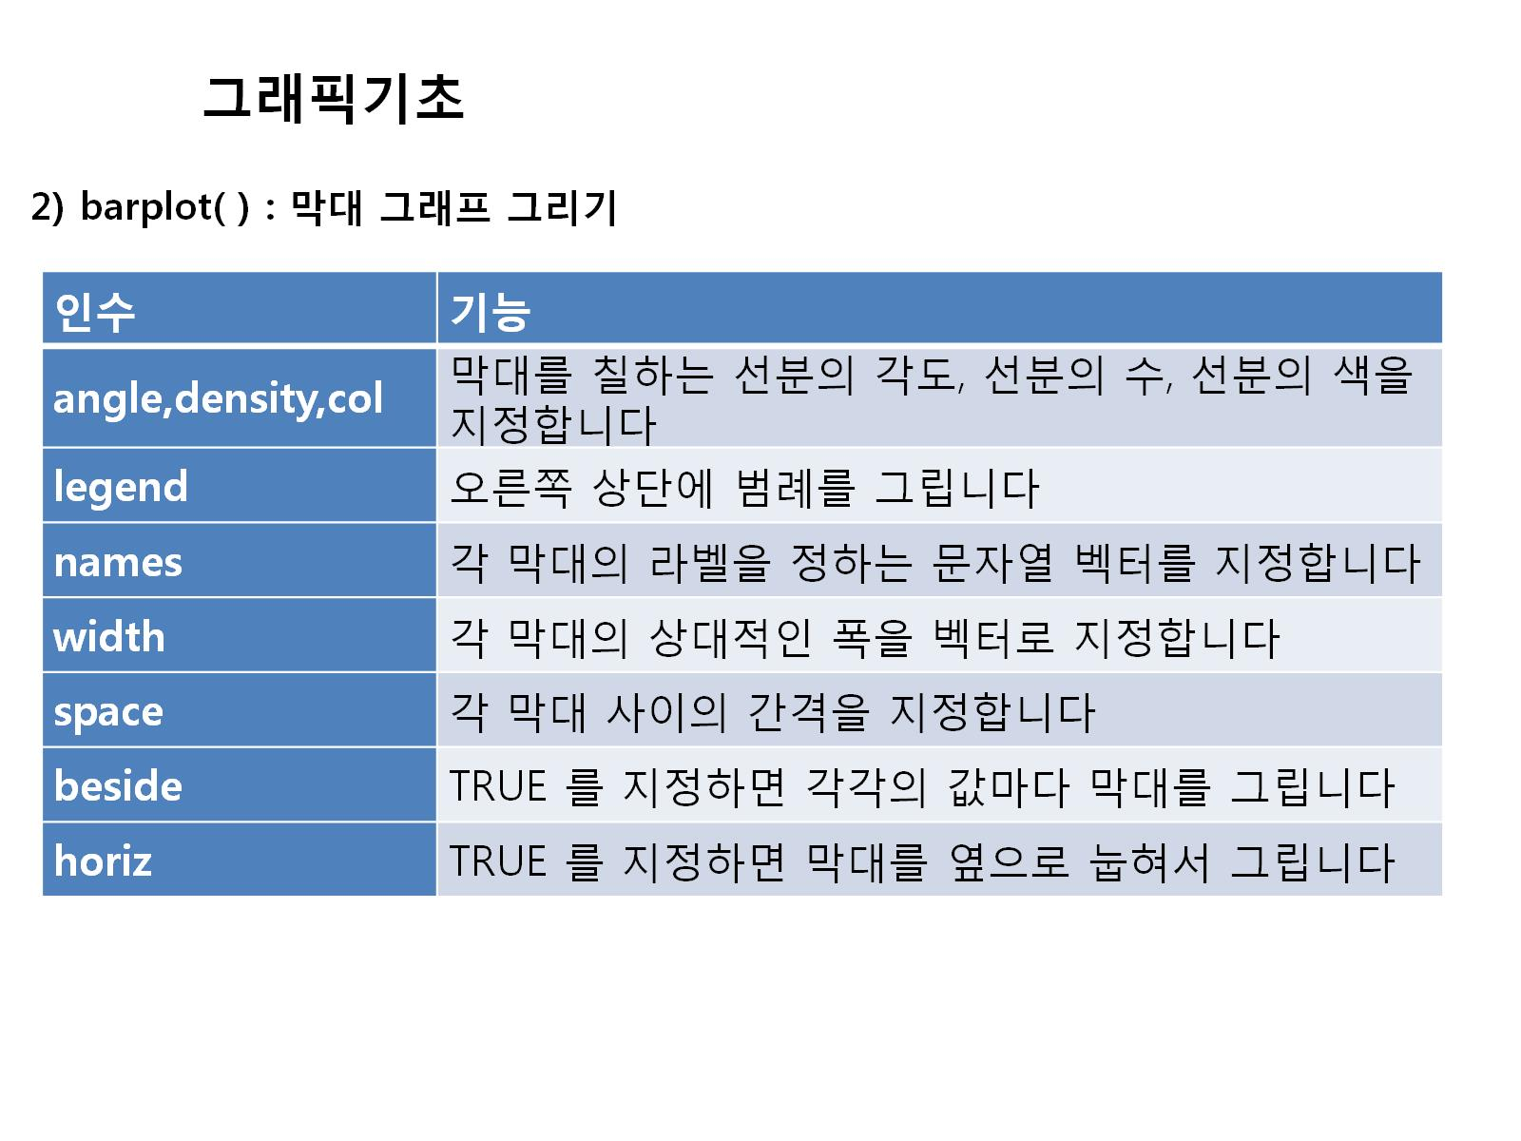

Slide 42
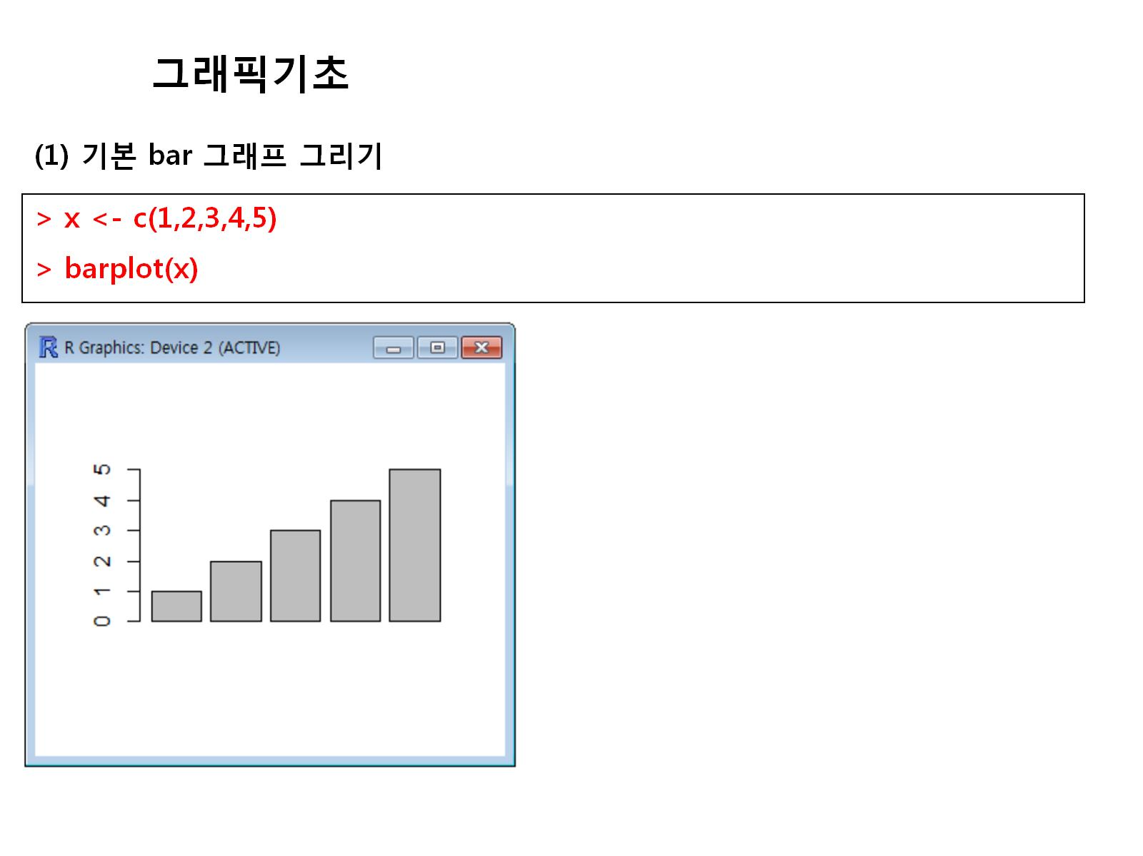

Slide 43
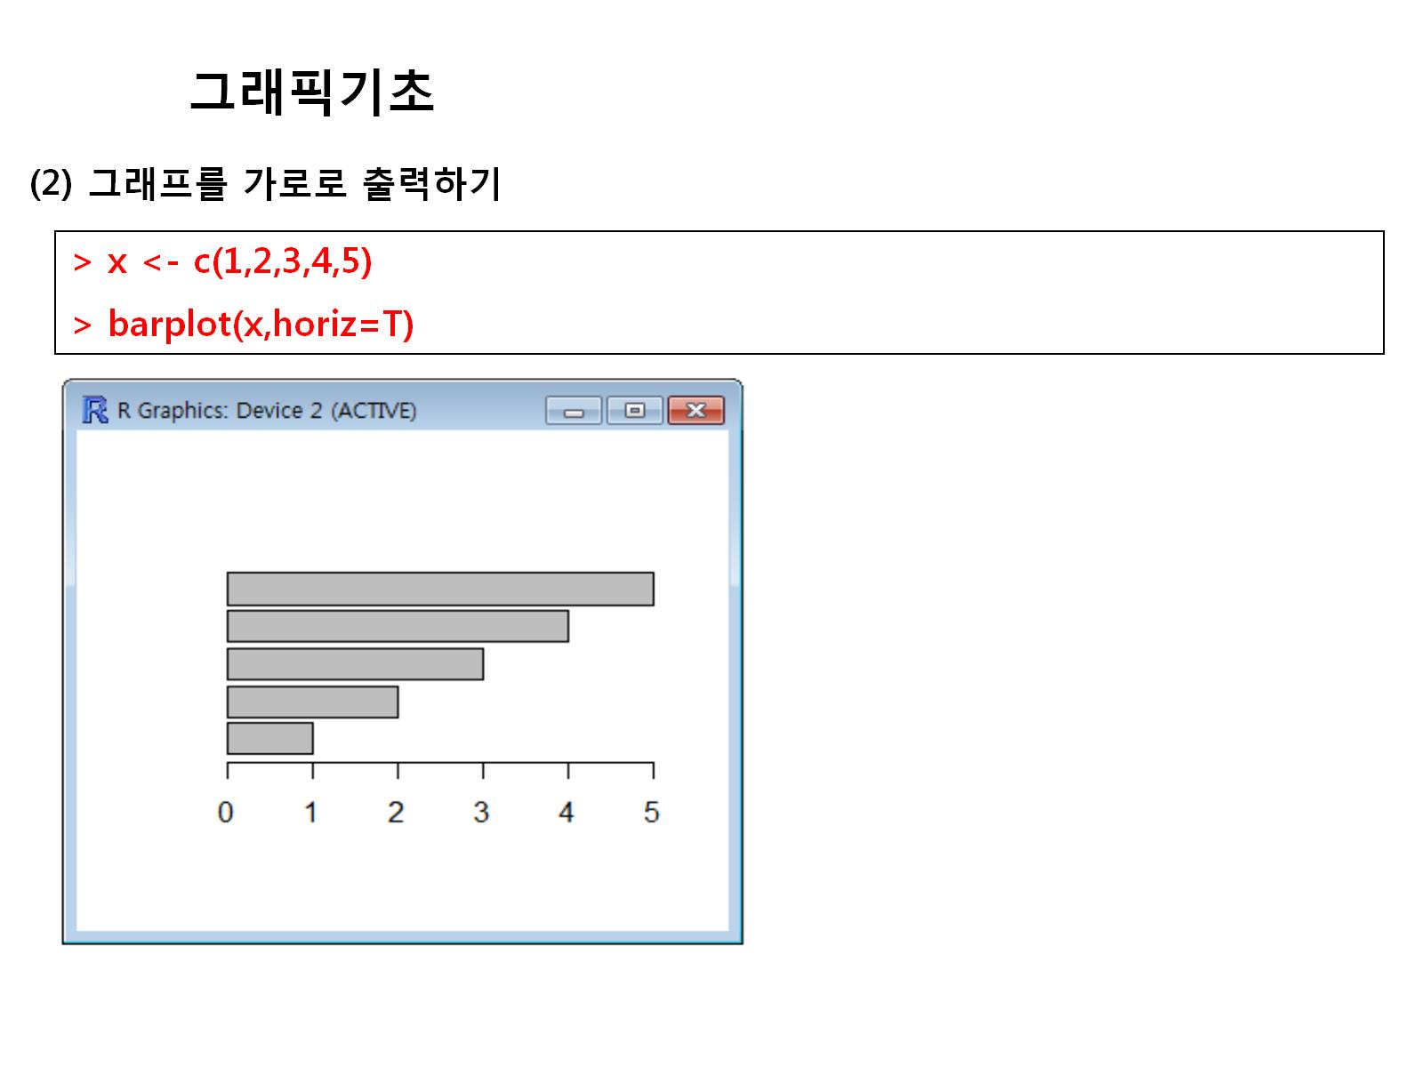

Slide 44
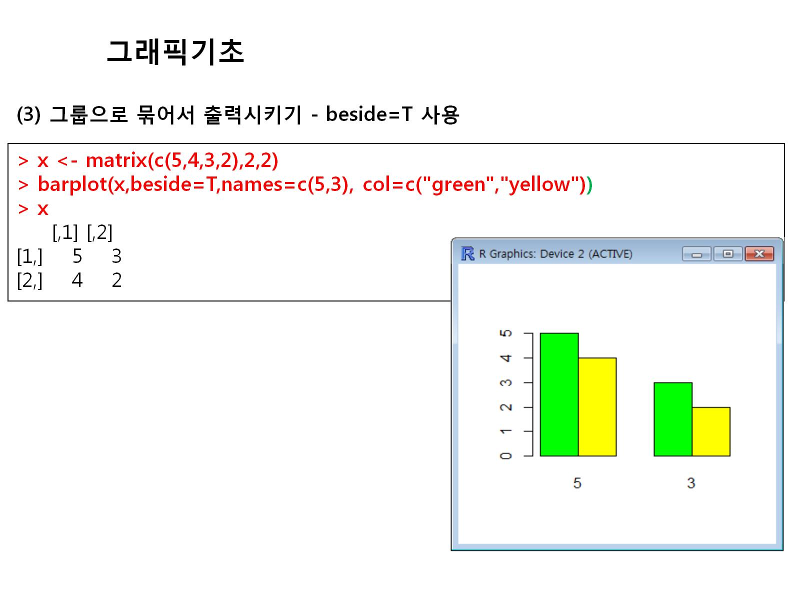

Slide 45
x<-c(1,2,3,4,5)
barplot(x)
x<-c(1,2,3,4,5)
barplot(x,horiz=T)
x<-matrix(c(5,4,3,2),2,2)
barplot(x,beside=T,names=c(5,3),col=c("green","yellow"))
x

Slide 46
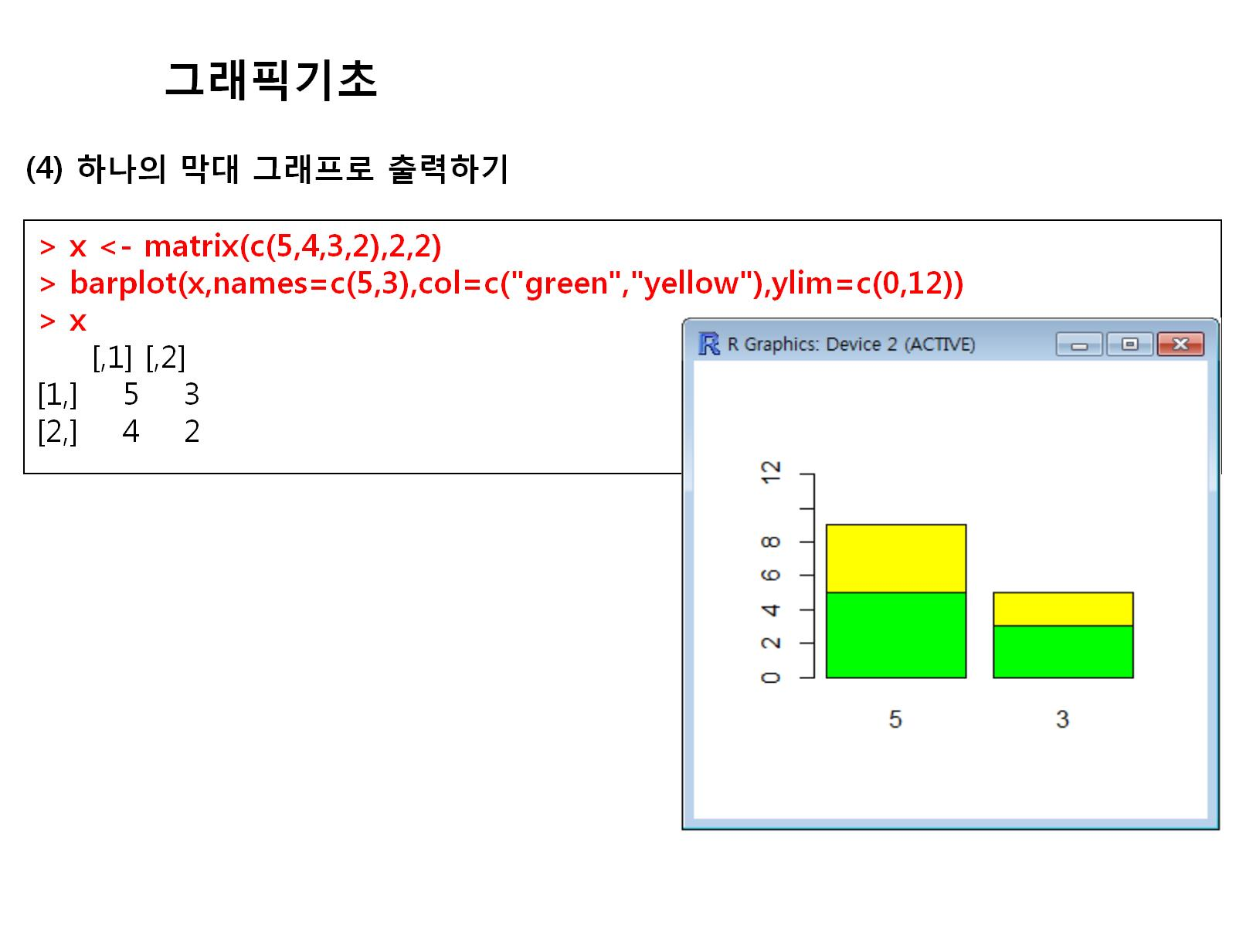

Slide 47
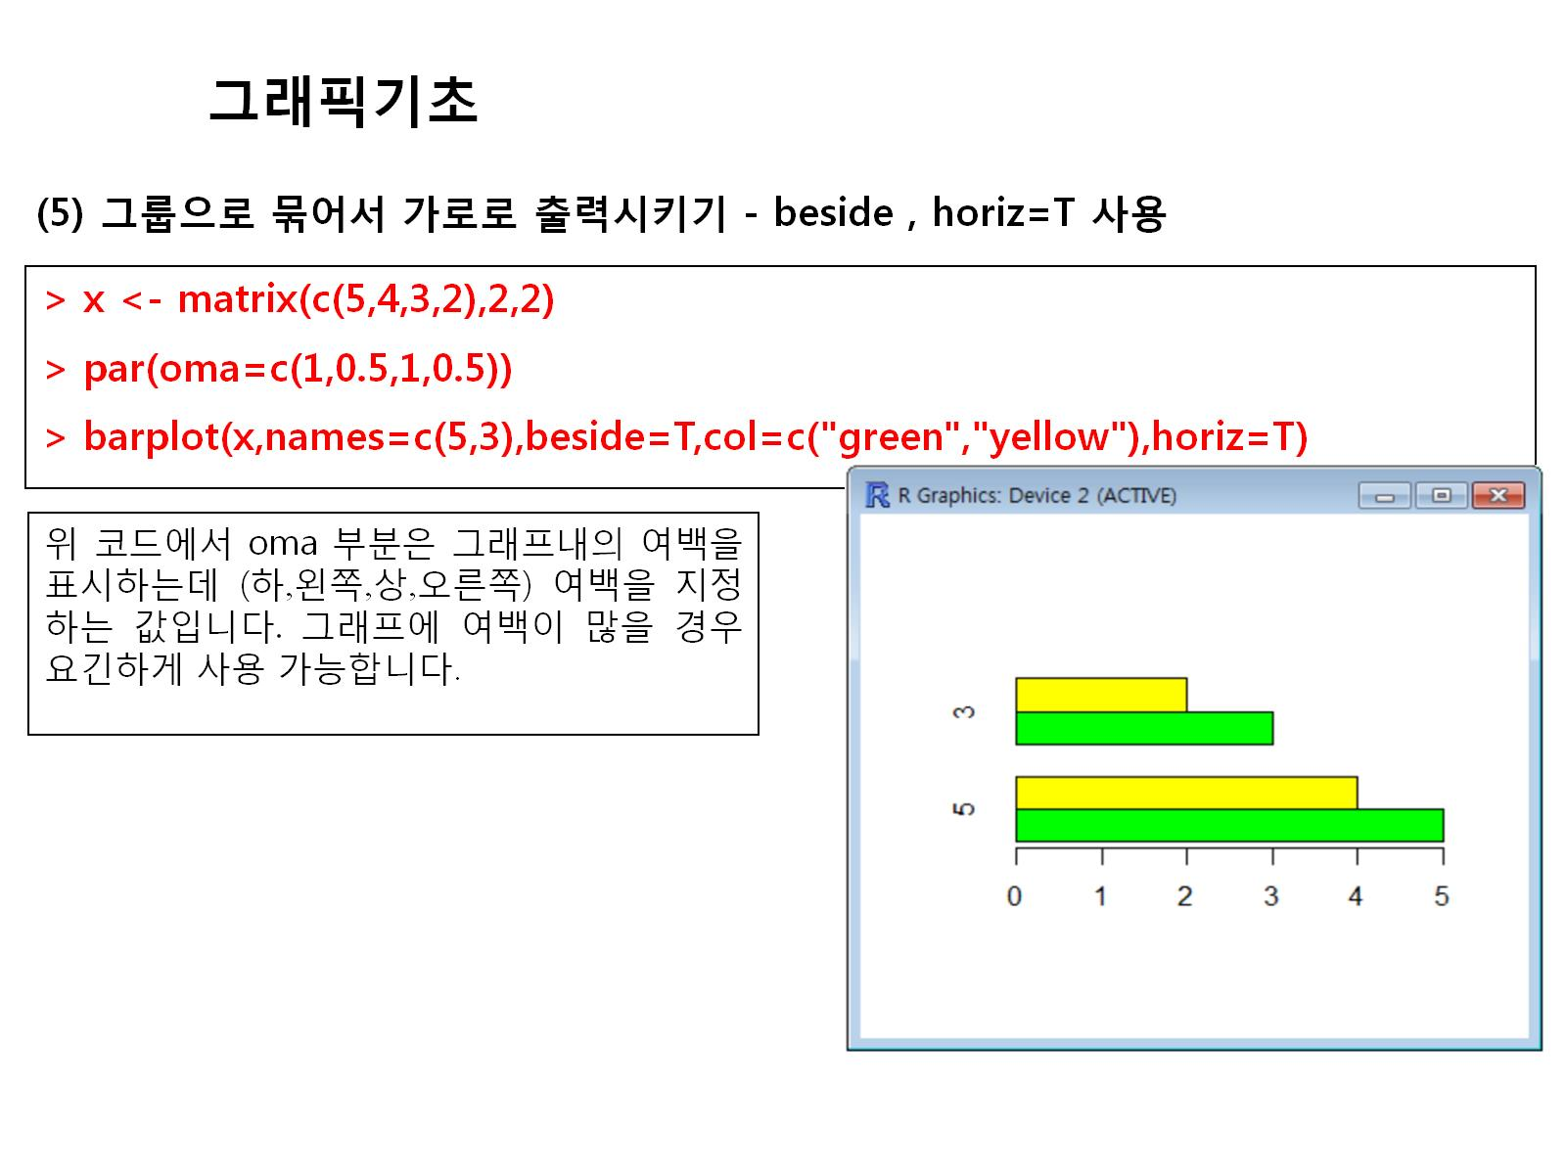

Slide 48
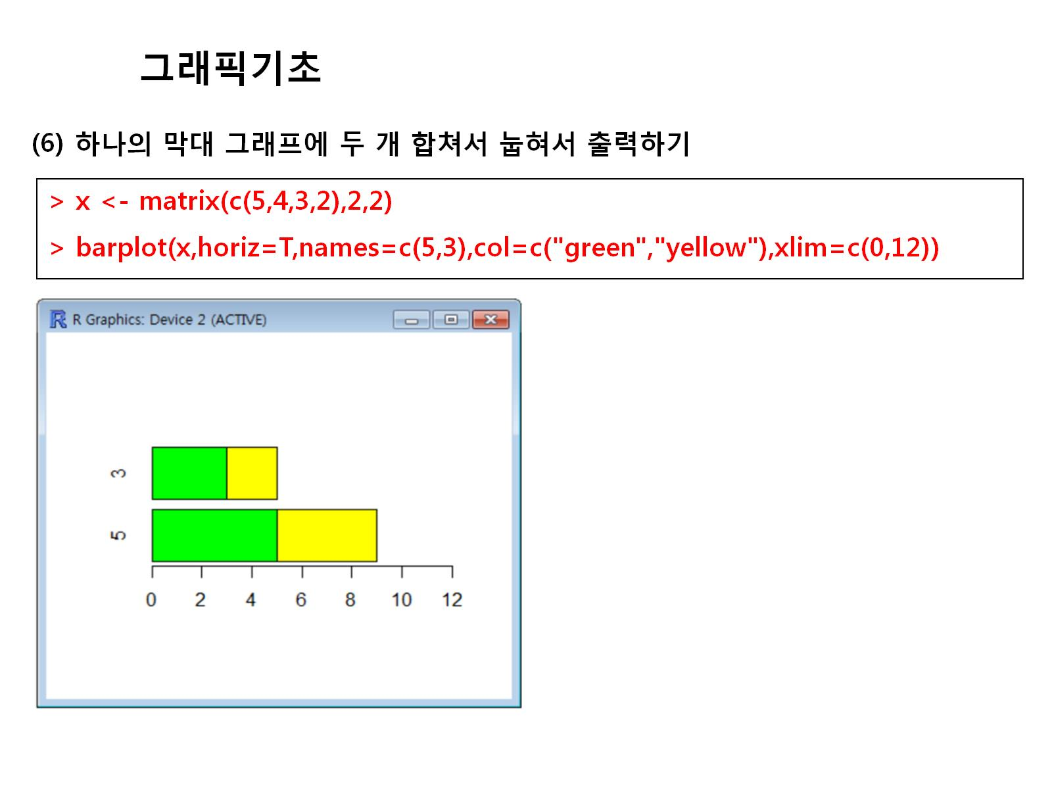

Slide 49
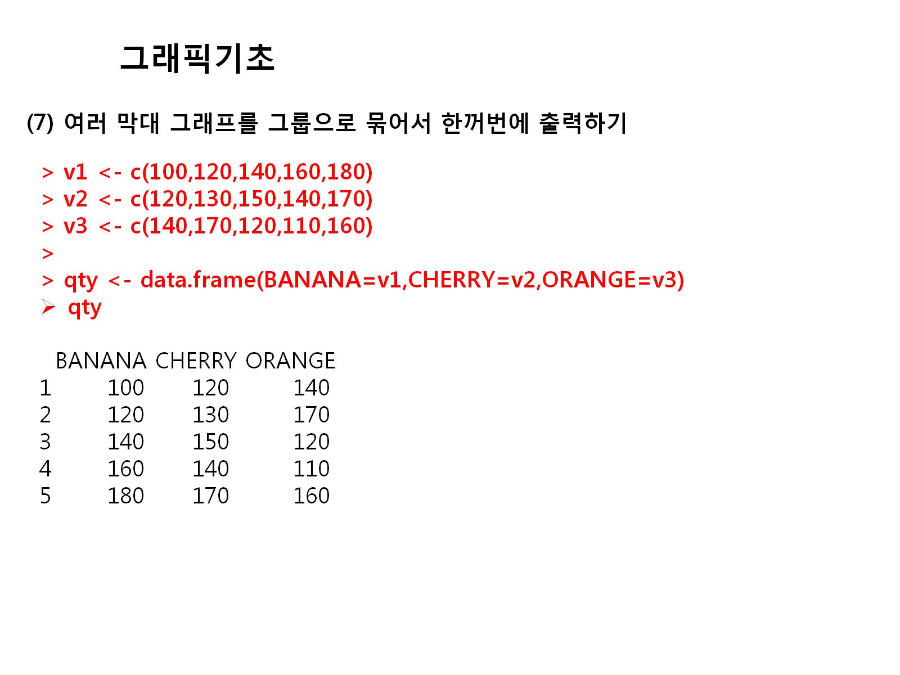

Slide 50
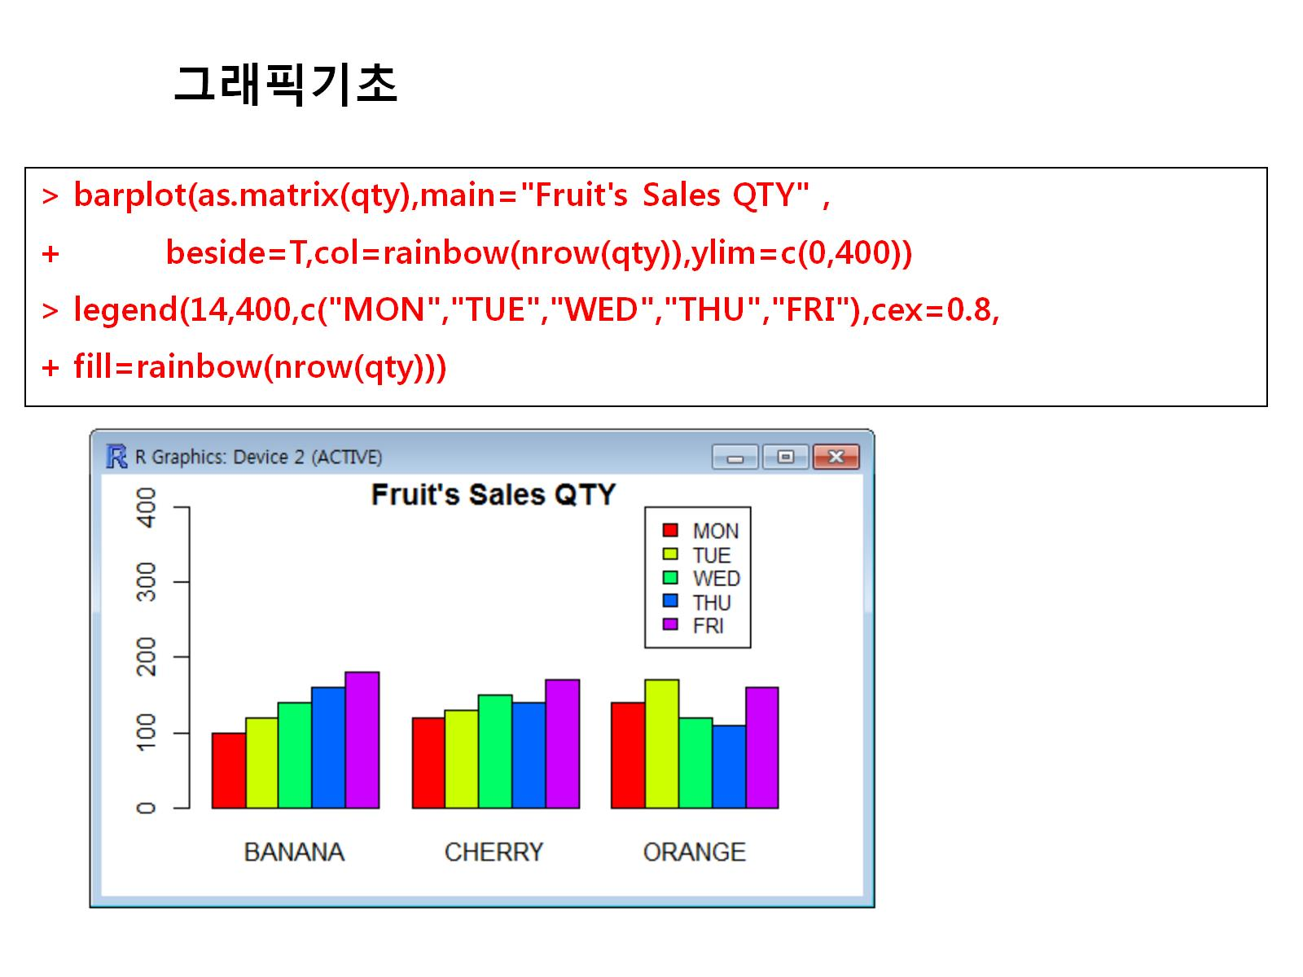

Slide 51
v1<-c(100,120,140,160,180)
v2<-c(120,130,150,140,170)
v3<-c(140,170,120,110,160)
qty<-data.frame(BANANA=v1,CHERRY=v2,ORANGE=v3)
qty
barplot(as.matrix(qty),main="Fruit's Sales QTY",beside=T,col=rainbow(nrow(qty)),ylim(0,400))
legend(14,400,c("MON","TUE","WED","THU","FRI"),cex=0.8,fill=rainbow(nrow(qty)))

Slide 52


Slide 53
barplot(t(qty),main="Fruit's Sales QTY",ylim(0,900),col=rainbow(length(qty)),space=0.1,cex.axis = 0.8,las=1,names.arg=c("MON","TUE","WED","THU","FRI"),cex=0.8)
legend(0.2,800,names(qty),cex=0.7,fill=rainbow(length(qty)))

Slide 54


Slide 55


Slide 56


Slide 57
peach<-c(180,200,250,198,170)
colors<-c()
for(i in 1:length(peach))
{if (peach[i]>=200)
{colors<-c(colors,"red")}
else if(peach[i]>=180)
{colors<-c(colors,"yellow")}
else
{colors<-c(colors,"green")}
}
barplot(peach,main="Peach Sales QTY",names.arg=c("MON","TUE","WED","THU","FRI"),col=colors)

Slide 58

Notes:
height<-c(182,175,167,172,163,178,181,166,159,155)
hist(height,main = "histogram of height")

Slide 59

Notes:
par(mfrow=c(1,2),oma=c(2,2,0.1,0.1))
hist<-c(1,1,2,3,3,3)
hist(hist)
plot(hist,main="Plot")

Slide 60


Slide 61

Notes:
par(mfrow=c(1,1),oma=c(0.5,0.5,0.1,0.1))
p1<-c(10,20,30,40)
pie(p1,radius=1)

Slide 62


Slide 63

Notes:
par(mfrow=c(1,1),oma=c(0.5,0.5,0.1,0.1))
p1<-c(10,20,30,40)
pie(p1,radius=1)
pie(p1,radius=1,init.angle = 90)
pie(p1,radius=1,init.angle = 90,col=rainbow(length(p1)),label=c("Week1","Week2","Week3","Week4"))

Slide 64

Notes:
pct<-round(p1/sum(p1)*100,1)
lab<-paste(pct,"%")
pie(p1,radius=1,init.angle = 90,col=rainbow(length(p1)),labels = lab)
legend(1,1.1,c("Week1","Week2","Week3","Week4"),cex=0.5,fill=rainbow(length(p1)))

Slide 65


Slide 66


Slide 67

Notes:
p1<-c(10,20,30,40,50)
f_day<-round(p1/sum(p1)*100,1)
f_label<-paste(f_day,"%")
pie3D(p1,main="3D Pie Chart", col=rainbow(length(p1)),cex=0.5,labels=f_label,explode=0.05)
legend(0.5,1,c("MON","TUE","WED","THU","FRI"),cex=0.6,fill=rainbow(length(p1)))

Slide 68
p1<-c(10,20,30,40,50)
f_day<-round(p1/sum(p1)*100,1)
f_label<-paste(f_day,"%")
pie3D(p1,main="3D Pie Chart", col=rainbow(length(p1)),cex=0.5,labels=f_label,explode=0.05)
legend(0.5,1,c("MON","TUE","WED","THU","FRI"),cex=0.6,fill=rainbow(length(p1)))

Slide 69

Notes:
v1<-c(10,12,15,11,20)
v2<-c(5,7,15,8,9)
v3<-c(11,20,15,18,13)
boxplot(v1,v2,v3)

Slide 70
pct<-round(p1/sum(p1)*100,1)
lab1<-c("Week1","Week2","Week3","Week4")
lab2<-paste(lab1,"\n",pct,"%")
pie(p1,radius=1,init.angle = 90,col=rainbow(length(p1)),labels = lab)
legend(1,1.1,c("Week1","Week2","Week3","Week4"),cex=0.5,fill=rainbow(length(p1)))
install.packages("plotrix")
p1<-c(10,20,30,40,50)
f_day<-round(p1/sum(p1)*100,1)
f_label<-paste(f_day,"%")
pie3D(p1,main="3D Pie Chart", col=rainbow(length(p1)),cex=0.5,labels=f_label,explode=0.05)
legend(0.5,1,c("MON","TUE","WED","THU","FRI"),cex=0.6,fill=rainbow(length(p1)))
v1<-c(10,12,15,11,20)
v2<-c(5,7,15,8,9)
v3<-c(11,20,15,18,13)
boxplot(v1,v2,v3)

Slide 71

Notes:
v1<-c(10,12,15,11,20)
v2<-c(5,7,15,8,9)
v3<-c(11,20,15,18,13)
boxplot(v1,v2,v3,col=c("blue","yellow","pink"),names=c("Blue","Yellow","Pink"),horizontal = T)

Slide 72


Slide 73


Slide 74


Slide 75


Slide 76


